Slide 1
What Makes Humans Unique
Among the Animals?
Day 2
Rationality Expressed in Human Language

Slide 2
Natural reason plays a key role in distinguishing human persons from other animals.
What is natural reason?
And what is it for?

Slide 3
Defining Natural Reason: Humankind’s Capacity for Understanding Things as They Are
“I do not just feel, I can also examine my feelings, approach them ‘objectively’, interpret them. I am not completely immersed in my world, I can look at it, can change it, compare it with other things, and can stand over against it in a critical spirit. I can think about it as well as about myself. This power cannot derive from animated matter, which cannot consider itself and stand over against itself.”
Cardinal Christoph Schönborn

Slide 4
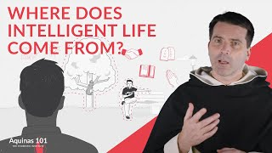
Homo sapiens: The Rational Animal
Watch.
Core Concept: Natural reason (rationality) is how we humans can understand the meaning of the world.
(Watch to 5:28)

Slide 5
In over 4 billion years of evolution on earth, the human being is the first material creature of its kind for whom being spiritual is its natural state.

Slide 6
Signs of a Rational Soul
A Brief Look at the Human Phenomenon of Symbolic Language

Slide 7
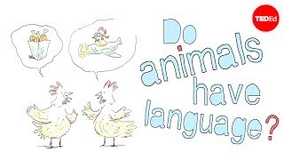
Animal Communication vs. Human Language
Watch.
What do humans and animals share in our systems of communication? In what ways do we differ?
A quick glimpse at various forms of animal communication – from bees to gophers to gorillas – and how they can differ from human language
(4:55)

Slide 8
“Animals’ topics of conversations are usually limited. Bees talk about food, prairie dogs talk about predators, and crabs talk about themselves. Human language stands alone. …The human brain can take a finite number of elements and create an infinite number of messages. We can craft and understand complex sentences, as well as words that have never been spoken before. We can use language to communicate about an endless range of subjects, talk about imaginary things, and even lie.”
Reflect & Discuss: Key Excerpt from Video.
Notes:
See Teacher Copy of Worksheet for Notes on Key Takeaways

Slide 9
Human language is symbolic in nature.
In the rational animal, words and images no longer just mean what they immediately signify; they become carriers of intangible meanings.

Slide 10
Understanding Symbolic Language
“The gazelle knows the lion as a threat; we too are capable of knowing the lion as a threat – and also as a collection of organic compounds, as a symbol of royalty, as maned in males and maneless in females, as a mammal, as threatened with extinction….”
Theologian Christopher Baglow

Slide 11
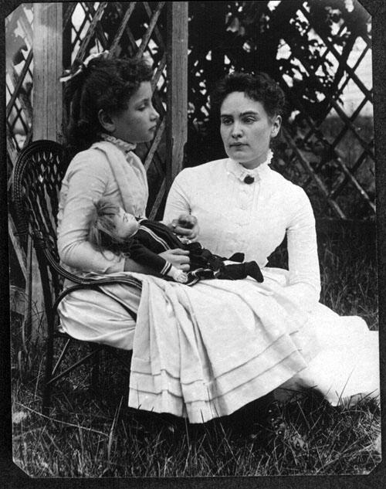
Read & Discuss.
Case Study: Helen Keller’s Discovery of Symbolic Language
Context: Left deaf and blind from disease in infancy, Helen Keller could actually recount the moment she discovered language as an older child.

Slide 12
Read & Discuss.
Case Study: Helen Keller’s Discovery of Symbolic Language
“That living word (water) awakened my soul, gave it light, hope, joy, set it free! … I left the well-house eager to learn. Everything had a name and each name gave birth to a new thought.”

Slide 13
Human rationality is discernible
in our language, which is uniquely symbolic.
Symbolic language expresses our rationality. It helps us pursue the truth.
Review of Day 2.

Slide 14
Our rationality is for the pursuit of truth & the realization of love.
Our capacity for understanding truth is for the purpose of knowing & loving God
and one another.
Review of Day 2.

Slide 15
(Slide 3) Hand and Lightbulb: Zdenek Sasek via Canvas
(Slide 4) Video by The Thomistic Institute
(Slide 5) Map Illustration by Clker-Free-Vector-Images via Canvas
(Slide 6) Lightbulb Illustration by Mariia Mazaeva via Canvas
(Slide 7) Video by Michele Bishop, Animation by Avi Ofer, Featured on TED-Ed
(Slide 8)
Bumblebee Illustration by Clker-Free-Vector-Images via Canvas
Brain Illustration by StarGladeVintage via Canvas
(Slide 9)
Bitten Apple Illustration by eyewave via Canvas
Cave Painting Illustration by ncp.18 from baddesigner via Canvas
Hand Holding Candle Illustration by anna42f via Canvas
(Slide 10)
Lion Illustration by Clker-Free-Vector-Images via Canvas
Quote from Chris Baglow, Lecture “Evolution and the Human Soul”
(Slide 12)
Water Illustration by by GDJ via Canvas
Quote from The Story of My Life by Helen Keller, pg 24.
(Slides 13-15) Globe Illustration by OpenClipart-Vectors via Canvas
Credits

