Slide 1
Human Uniqueness in Evolutionary History
Day 1
What makes humans different?

Slide 2
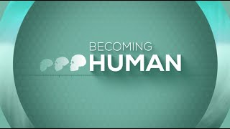
How Did Humans Become Human?
Series from the Dialogue on Science, Ethics & Religion program
Watch Part 1: How Did We Get Here?
Why are we are and none of the others are?
List characteristics from your initial brainstorm that seem most likely to address this.

Slide 3
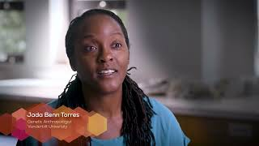
How Did Humans Become Human?
Series from the Dialogue on Science, Ethics & Religion program
Part 2: How Did Humans Survive Evolution?
What does it mean that humans “pursue meaning?”
Class Share: Edit your list as other students share.

Slide 4
Humanity is Made for Seeking Truth
"Meaning, whether it was spiritual or philosophical or artistic or scientific, that pursuit of meaning was part of the toolkit that evolved in our species, Homo sapiens. And that is absolutely critical in living in a world of uncertainty and disruption."
Paleoanthropologist Rick Potts

Slide 5
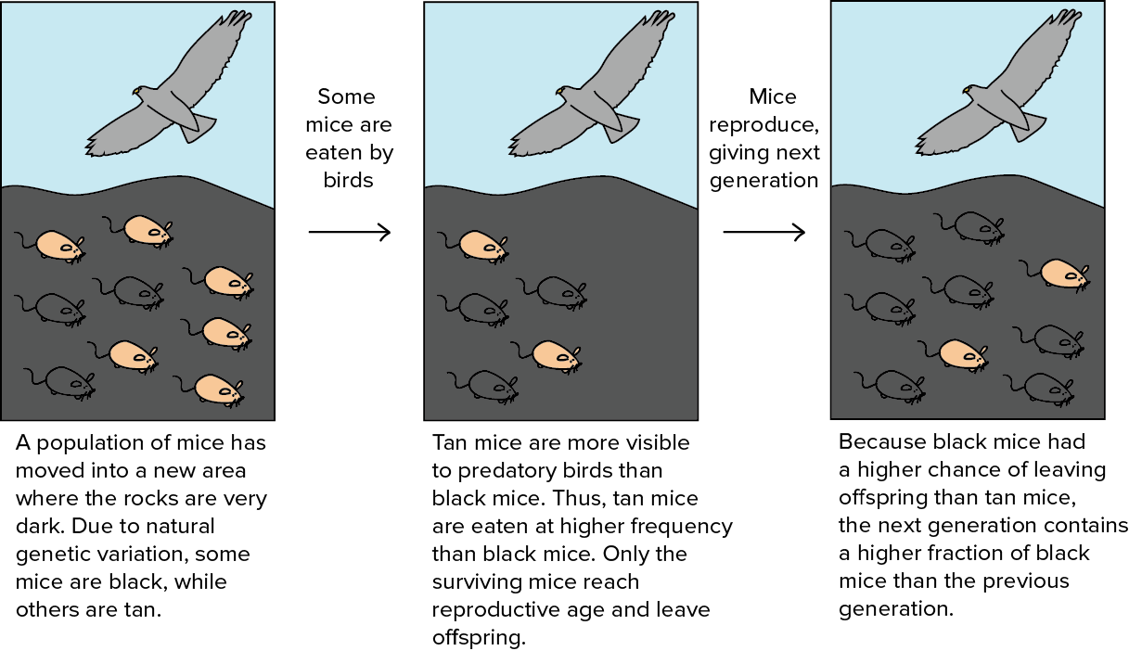
Figure #1: Natural Selection

Slide 6
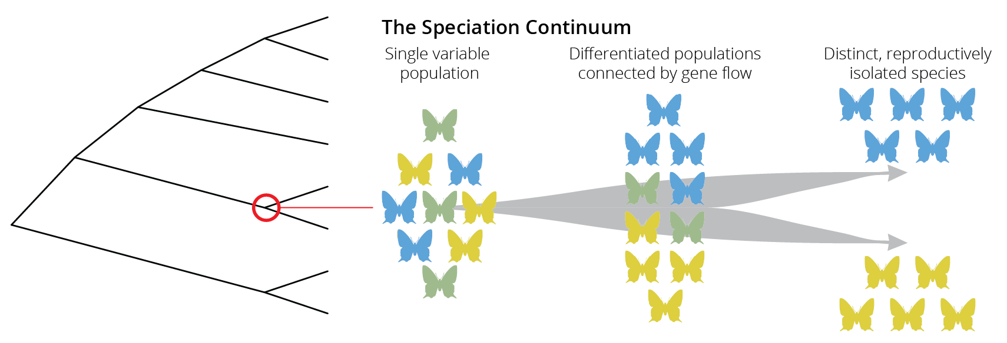
Figure #2: Speciation

Slide 7
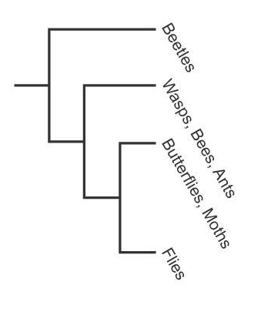
Figure #3: Cladogram

Slide 8
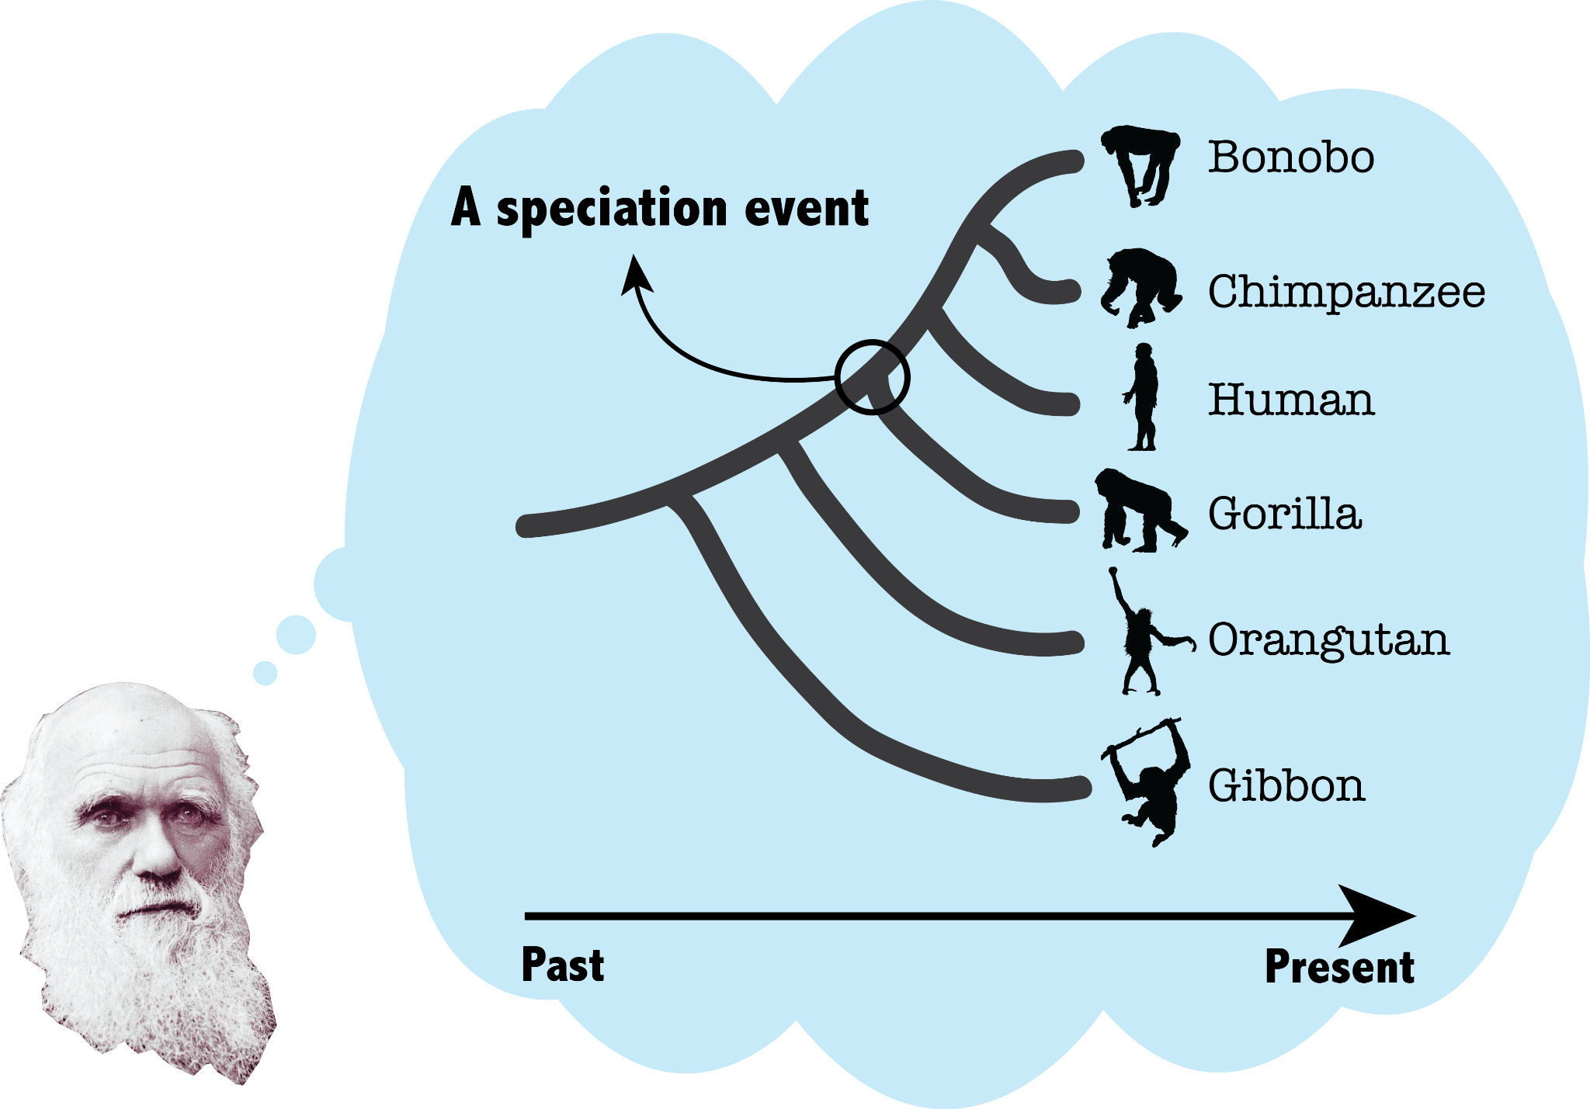
Figure #4: Primate Cladogram

Slide 9
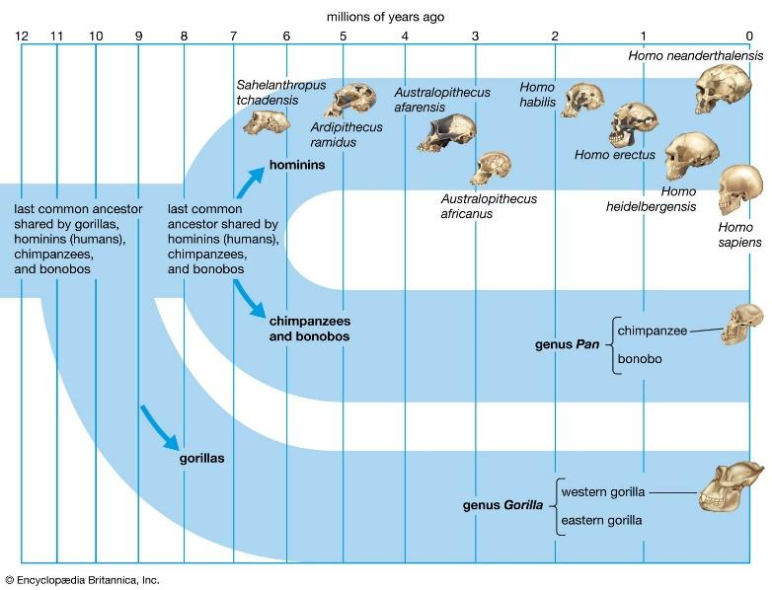
Figure #5: Hominin Cladogram (simple)

Slide 10
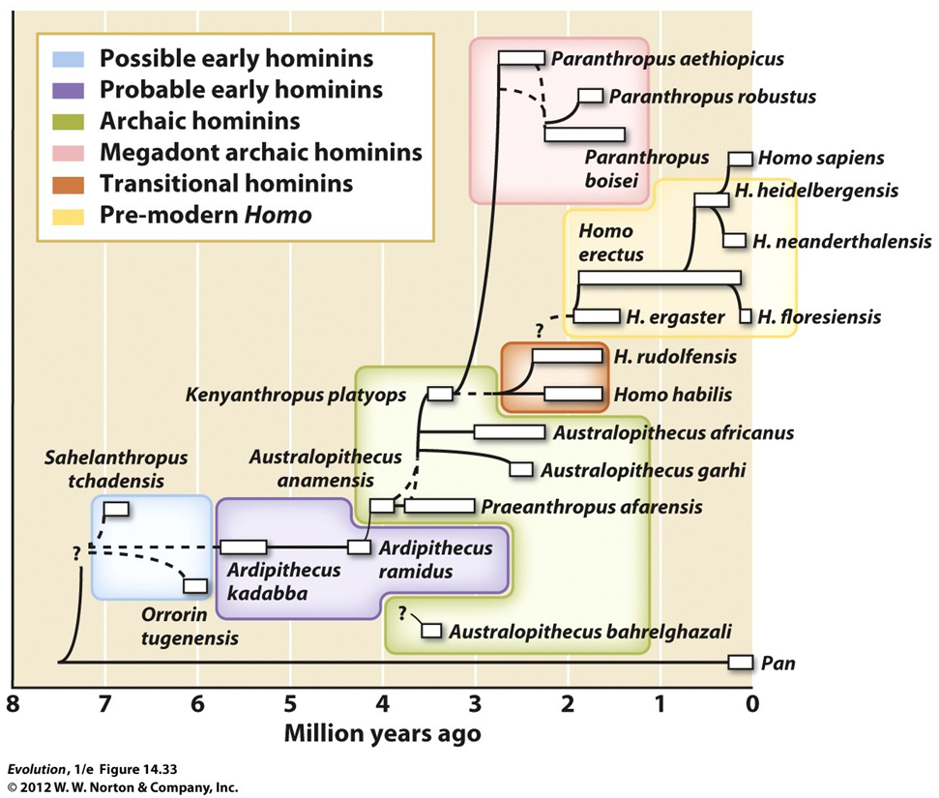
Figure #6: Hominin Cladogram (complex)

Slide 11
(Slide 3) Figure #1: Berhttps://www.khanacademy.org/science/high-school-biology/hs-evolution/hs-evolution-and-natural-selection/a/hs-evolution-and-natural-selection-review
(Slide 4) Figure #2: https://michitobler.github.io/primer-of-evolution/speciation-1.html
(Slide 5) Figure #3: https://brainly.com/question/22273060
(Slide 6) Figure #4: https://blogs.iu.edu/sciu/2017/09/26/why-are-there-still-apes/
(Slide 7) Figure #5: https://www.britannica.com/science/human-evolution
(Slide 8) Figure #6: Bergstrom & Dugatkin. Evolution, 1st edition. 2012. Figure 14.33.
Image Credits

