Slide 1
The Mystery of Light
“For with you is the fountain of life, and in your light, we see light…”
Psalm 36:10

Slide 2
“In the beginning was the Word, and the Word was with God and the Word was God…. All things came to be through him, and without him nothing came to be.”
John 1:1-3
“But you have disposed all things by measure and number and weight.”
Wisdom 11:20

Slide 3
Galileo Galilei (1564-1642)
“Philosophy is written in this all-encompassing book that is constantly open before our eyes, that is the universe; but it cannot be understood unless one first learns to understand the language and knows the characters in which it is written. It is written in mathematical language, and its characters are triangles, circles, and other geometrical figures; without these it is humanly impossible to understand a word of it, and one wanders around pointlessly in a dark labyrinth.”
The Assayer
Translation of The Assayer by Maurice A. Finocchiaro in The Essential Galileo (Hackett, 2008), 183.

Slide 4
Rene Descartes (1596-1650)
“Those long chains of utterly simple and easy reasonings that geometers commonly use to arrive at their most difficult demonstrations had given me occasion to imagine that all the things that can fall within human knowledge follow from one another in the same way […]. But what pleased me most about this method was that by means of it I was assured of using my reason in everything, if not perfectly, at least as well as was in my power; and in addition that I felt that in practicing this method my mind was little by little getting into the habit of conceiving its objects more rigorously and more distinctly and that, not having restricted the method to any particular subject matter, I promised myself to apply it as usefully to the problems of the other sciences as I had to those of algebra.”
Discourse on Method §II
Translation by D. Cress in Discourse on Method (Hackett, 1999), 183.

Slide 5
Do not all charms fly At the mere touch of cold philosophy? There was an awful rainbow once in heaven: We know her woof, her texture; she is given In the dull catalogue of common things. Philosophy will clip an Angel's wings, Conquer all mysteries by rule and line, Empty the haunted air, and gnomèd mine— Unweave a rainbow, as it erewhile made The tender-person'd Lamia melt into a shade.
John Keats (1795-1821), Lamia, 229-238

Slide 6
But is it true? Does science conquer all mysteries by rule and line?
Wonder: Light from Light
from

Slide 7
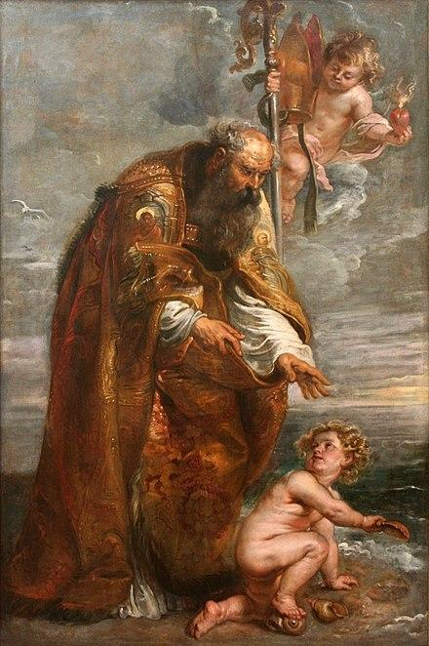
St. Augustine (354-430)
Si comprehendis non est Deus…
“It can only be understood in ways beyond words; human words cannot suffice for understanding the Word of God. […] You see, it is a kind of form, a form that has not been formed, but is the form of all things that have been formed; an unchangeable form, that has neither fault nor failing, beyond time, beyond space, standing apart as at once the foundation for all things to stand on, and the ceiling for them to stand under. If you say that all things are in it, you are not lying. […] But you are quite unable to imagine or think of such a thing. And such ignorance is more religious and devout than any presumption of knowledge. After all, we are talking about God […] so why be surprised if you cannot grasp it? I mean, if you can grasp it, it isn’t God. Let us rather make a devout confession of ignorance, instead of a brash profession of knowledge.”
Sermon 117 §5
Translation of Sermon 117 §5 by E. Hill in St. Augustine, Essential Sermons (New City Press, 2007), 196-197.

Slide 8
Mystery – Obstacle or Horizon?
Is everything that transcends reason an obstacle to reason? Can the Creator not reveal what gives life to reason, like the ground of our reason as an image of the divine Logos?
2 + 2 = 5
“In the beginning was the Word…”

Slide 9
“For with you is the fountain of life,
and in your light, we see light…”
Psalm 36:10

