Slide 1
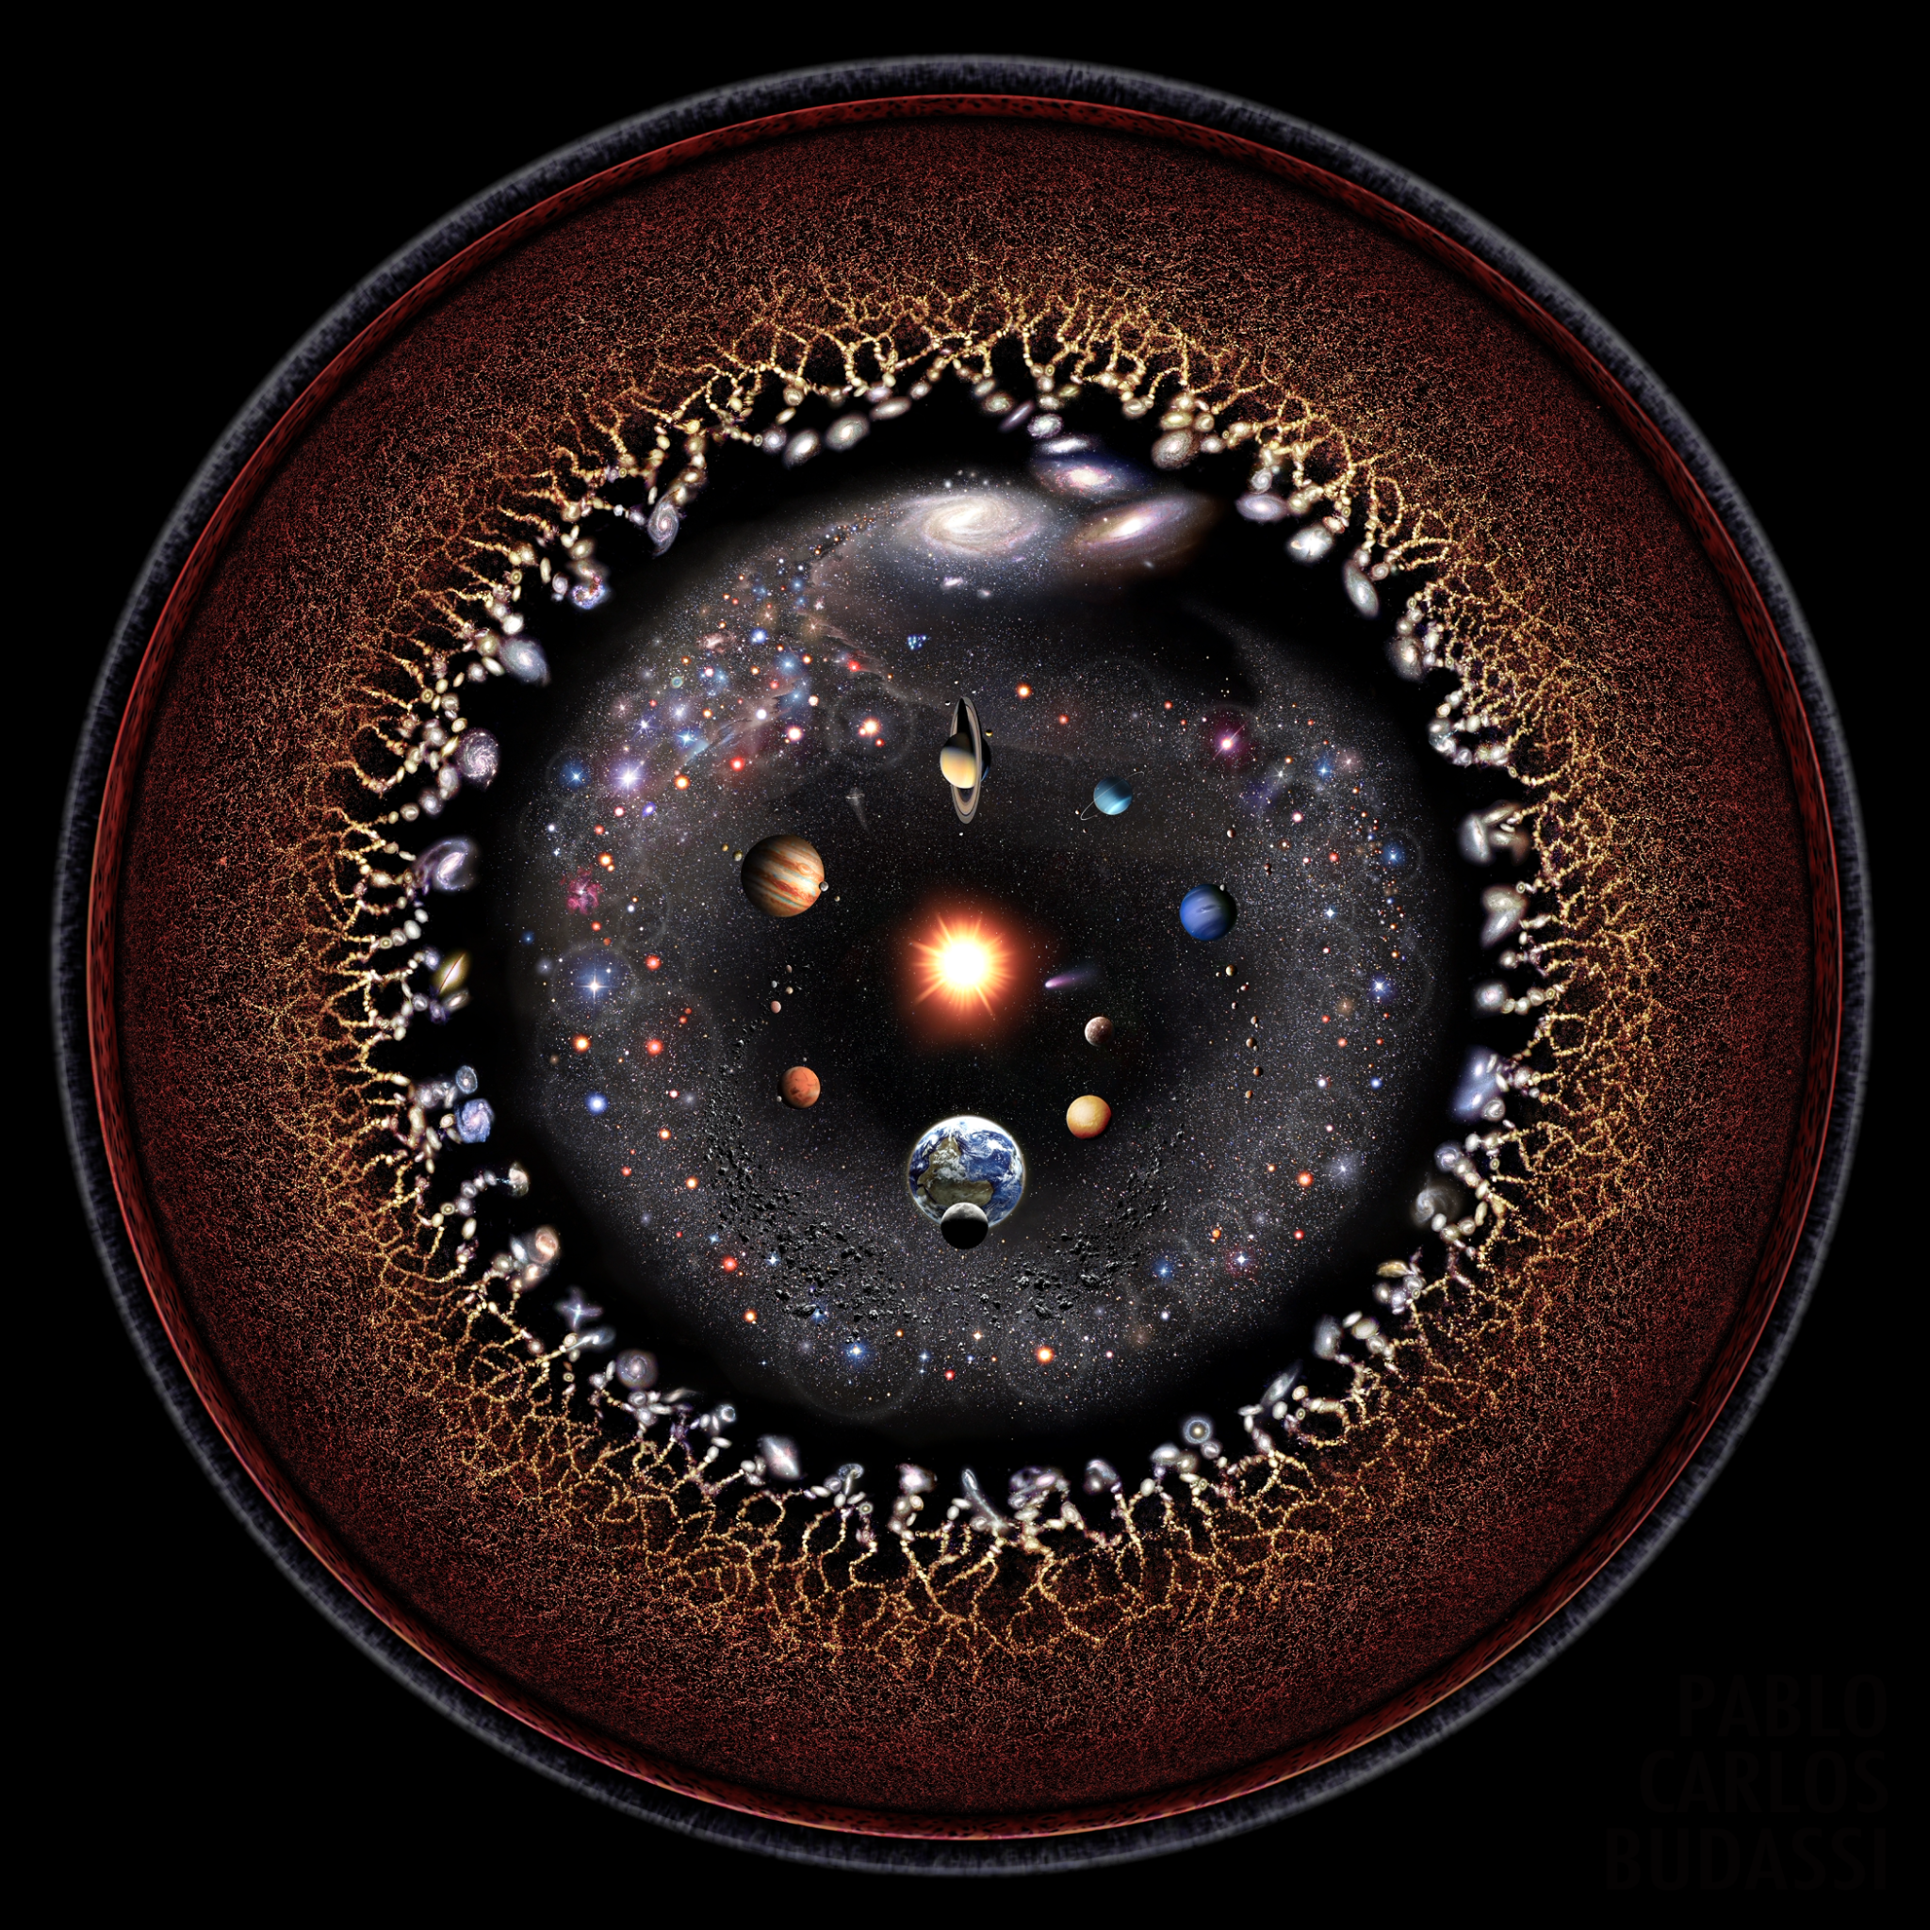
Contemporary Cosmology, Anthropic Coincidences, and the Question of God

Slide 2
Essential Questions
What is the Big Bang Theory, and how does it differ from the cosmological theory and ideas that preceded it?
How can the discoveries of modern physics relating to the “Anthropic Coincidences” help us to better appreciate the truth about God the Creator?
Can science prove or disprove the existence of God?

Slide 3
A Universe that Always Was?
What if the universe was eternal? Would that eliminate the need for a Creator?

Slide 4
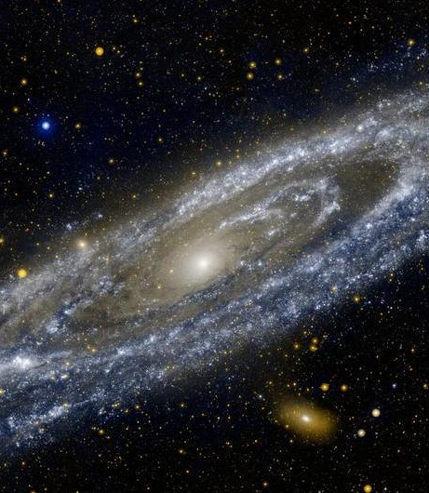
Science says…
Idea of a perpetual universe has been around for a long time
Two scientific discoveries in the 19th century seemed to support this belief:
Law of the conservation of mass
Law of the conservation of energy

Slide 5
What about God?
This cosmological picture would have serious implications for belief in God
If the universe has always existed, does that mean God did not create it?
And if God did not create the universe, does this mean that perhaps God doesn’t exist?
Does this falsify the Genesis creation account?
If we no longer need God to explain how the universe came to be, then what do we need God for?

Slide 6
Activity: the Perpetual Lamp
Even though the illumination of the ball had “no beginning” does that mean its illumination is ‘“uncaused”?
Notes:
Key question: Is it true that if something does not have a “beginning” (i.e. there was no moment in time at which it did not exist) that it is therefore “uncaused”?

Slide 7
The Doctrine of Creation
Creation is the act by which God gives reality to the universe
Creation deals with why anything exists at all
Notes:
Science deals with how

Slide 8
Creation is not only an "event" that happened at some time in the distant past.
The word "creation" has two meanings in theology:
Creatio ex Nihilo: Creation “out of nothing”
Creatio Continua: “Continuous Creation”

Slide 9
Only God ‘Creates’
Creation” refers to God’s act of bringing into existence of something from nothing
Creatures only create analogously

Slide 10
“Change” vs. “Creation”
Human creation = something something
Human “creation” involves giving shape to what already exists
Not creation, but merely the production of change
Notes:
Human “creation” is merely a change of some sort, a transition from one state to another.

Slide 11
Creation “Out of Nothing”
Divine creation = Nothing Something
Bringing into existence from “nothingness”
There is nothing that exists independently of God, no preexisting “stuff” to create out of
Notes:
It is not just saying that there was no matter for God to work from, it is articulating how radically different (philosophers say “ontologically different”) God is from the kinds of things we find in the universe today.

Slide 12
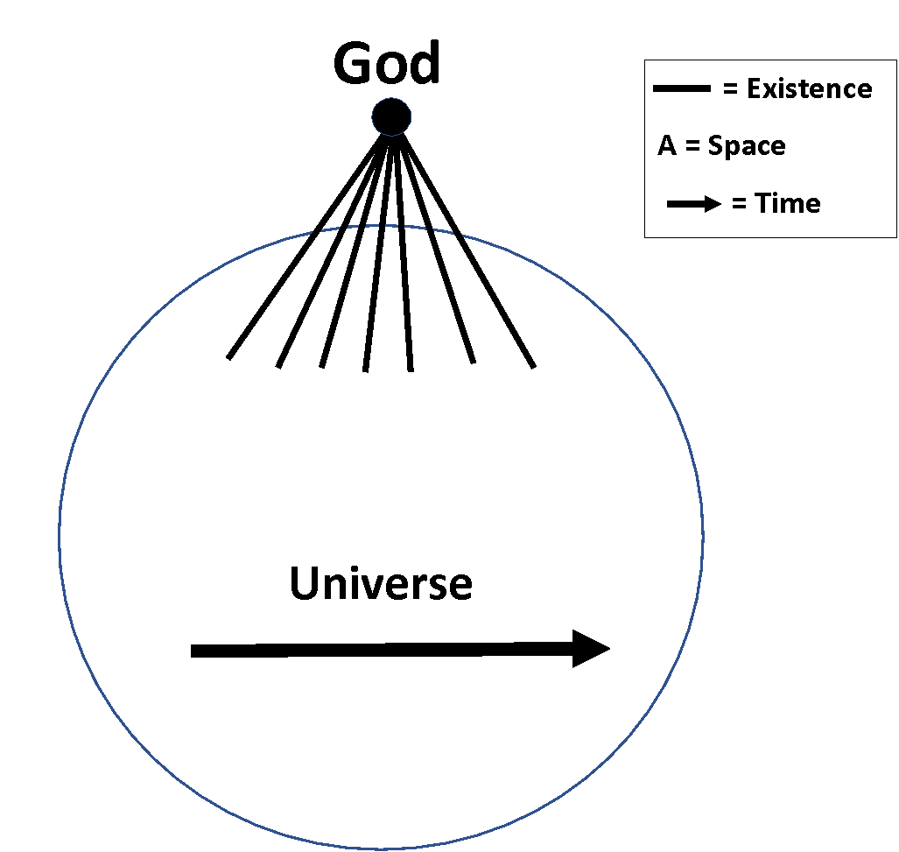
Diagram of the Causal Levels
Diagonal lines: God “passing on” existence to all contingent beings
“A” (Area of Circle): universe/all of created reality
Space/Time Area: Horizontal causes

Slide 13
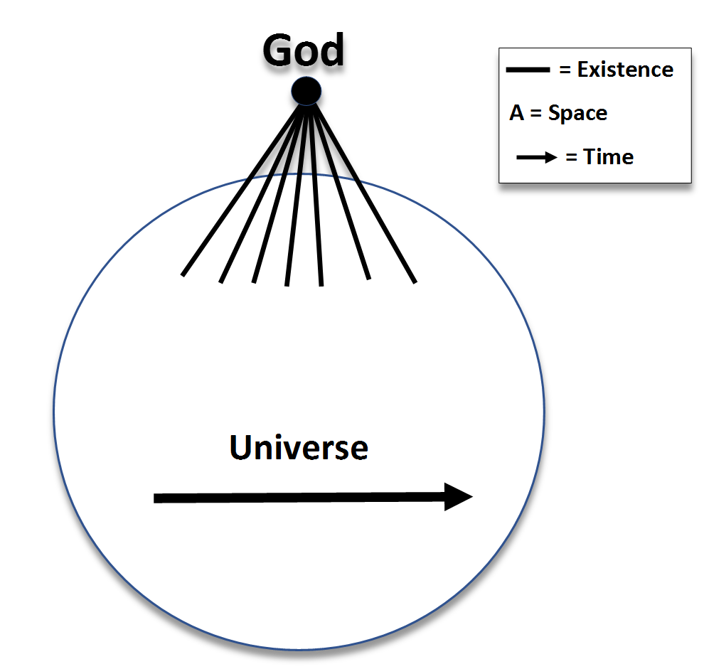
Continuous Creation
God causes created beings to exist, here and now.
Created beings are now depending on God for their very existence.
God created AND God creates
Notes:
The creative act begins with nothing, yet something created is the result. But more than the created product is the result; so also is the relationship of creator to what is created.

Slide 14
The Big Bang

Slide 15
The Big Bang
Space and Time:
• The Big Bang not only points to the beginning of stars and galaxies, but to the beginning of space and time as well.
• We cannot speak of “a time before the Big Bang” because there was no “time” before then. Any questions about time and space before then would be erroneous.
• Lemaître believed the Big Bang was “a day without a yesterday.”
• For St. Augustine time is the creation of God. There is only the present; we cannot experience the past or the future. We can measure time through the rising of the setting of the sun, and yet time remains somewhat of a mystery. God is outside of time and knows the past, present, and future as if one.

Slide 16
Cosmic Microwave Background (CMB) radiation

Slide 17
Cosmic Microwave Background (CMB) radiation
• A rapidly expanding universe expanded slowly among scientists.
• The Big Bang theory did not always enjoy the majority acceptance that it does today. Many, including the renowned Albert Einstein, were still very much tethered to the notion of a perpetual universe.
• Eventually Lemaître was able to win Einstein over. Einstein later called Lemaître’s theory, “The most beautiful and satisfactory explanation of creation to which I have ever listened.”

Slide 18
Cosmic Microwave Background (CMB) radiation
• Penzias and Wilson, accidently discovered significant supporting evidence for Lemaître’s Big Bang theory.
Video on CMB
• While working on an antenna Penzias and Wilson picked up a “noise” or “static” that eventually became known as the “cosmic microwave background radiation” (CMB). This remnant of radiation was the discovery that confirmed the Big Bang.
• Penzias and Wilson were awarded the Nobel Prize in Physics in 1978 for their discovery.

Slide 19
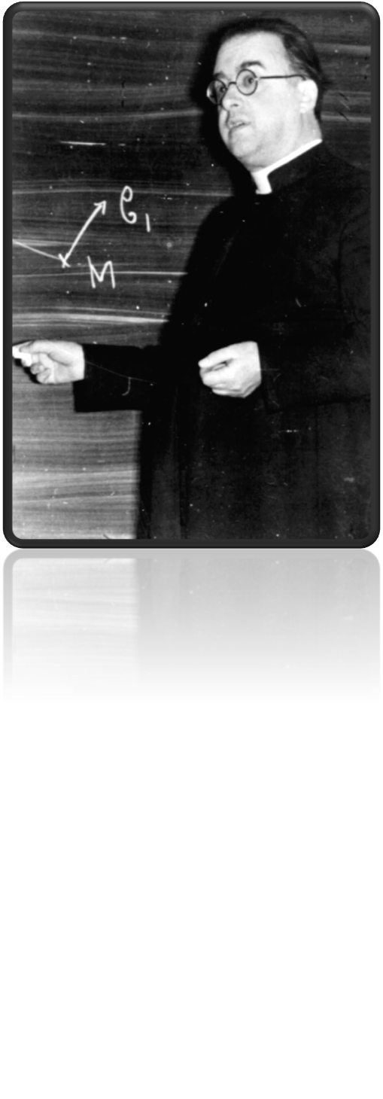
The Big Bang
Georges Lemaître (1894-1966)
was a Belgian priest and one of the two
originators of the Big Bang theory.
His work inspired Pope Pius XII to issue
a response supporting the ongoing studies
of theology and science.

Slide 20
The Big Bang
Georges Lemaître (1894-1966)
• “Father of Big-Bang cosmology”
• Ordained in 1923
• Studied at Math/Physics at Cambridge but also did studies at Oxford, Harvard, and MIT.

Slide 21
The Big Bang
Georges Lemaître (1894-1966)
In 1927 he proposed the “Big Bang” Theory. This theory, now strongly supported by observations and regarded as well established, shows that the present universe emerged from an explosion about 14 billion years ago, which is likely to have been the beginning of the universe and of time itself.
The “primeval atom.”
“The most beautiful and satisfactory explanation of creation to which I have ever listened.” – Einstein
In 1966 before his death his findings were confirmed.

Slide 22
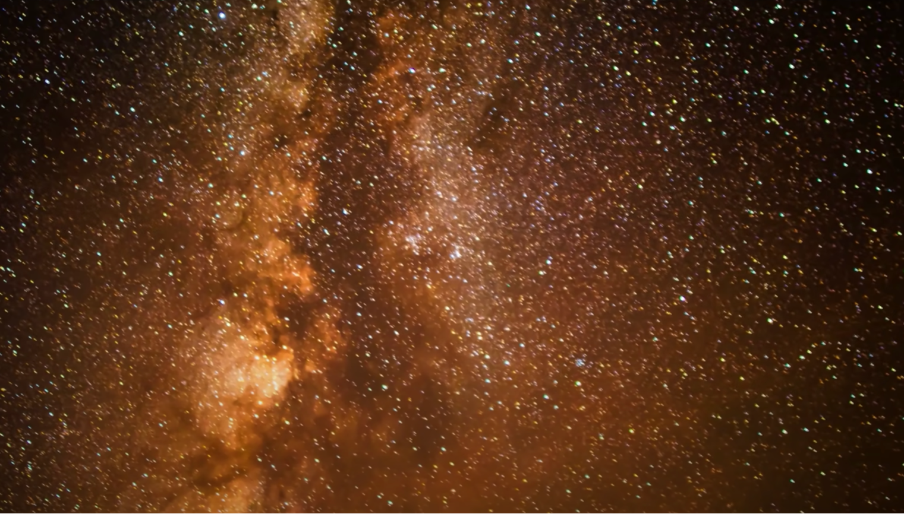
Day 3: Anthropic Coincidences and the Existence of God

Slide 23
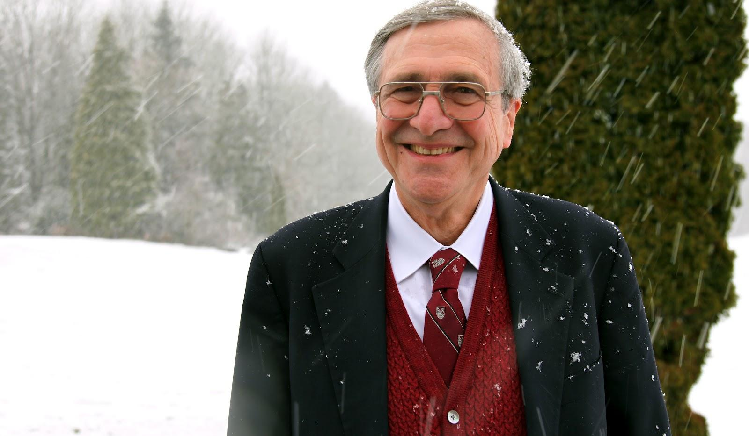
Peter Kreeft on the Argument from Design
What is the Argument from Design?
Do you agree or disagree with it and why?

Slide 24
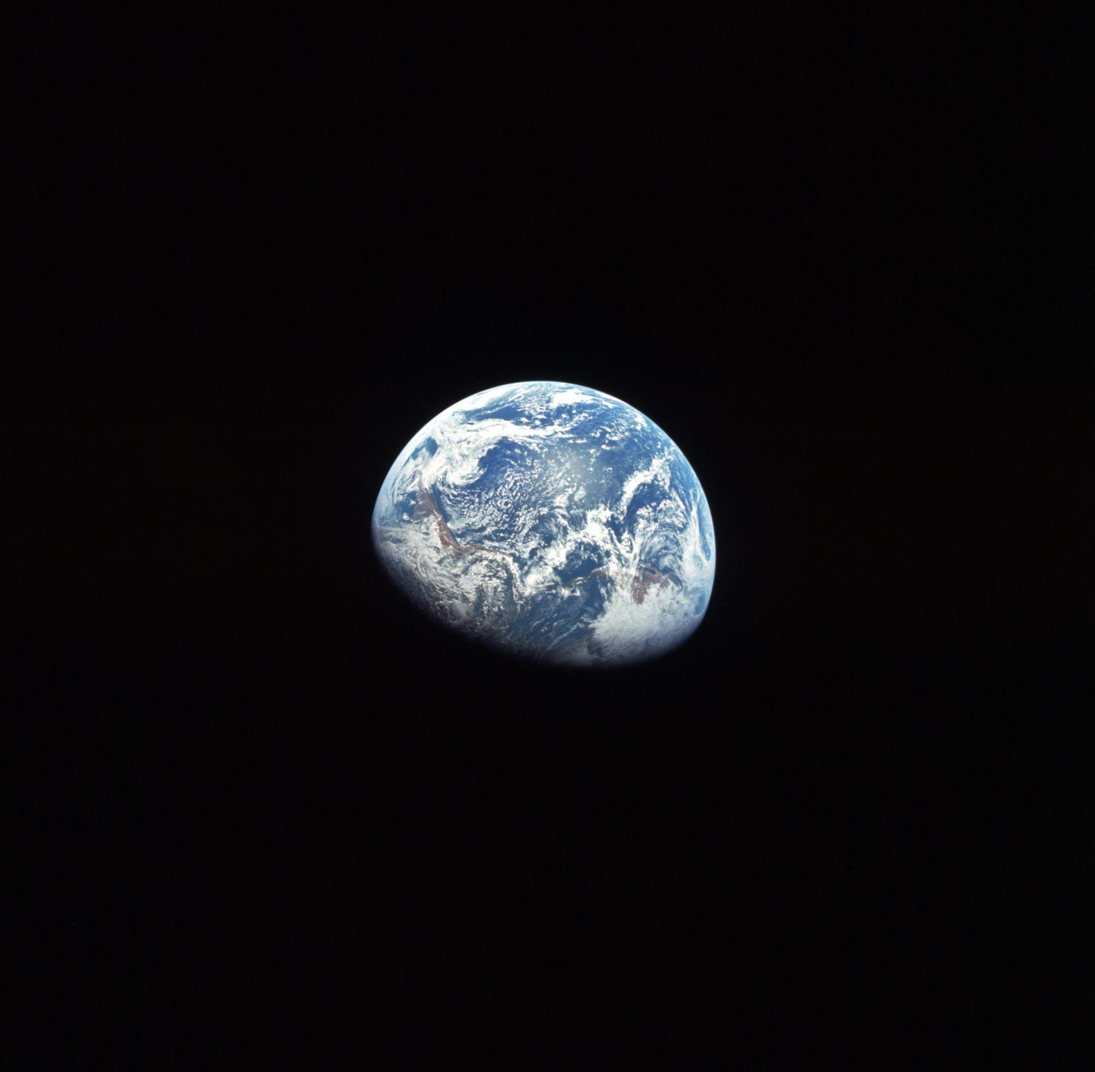
Anthropic Coincidences
“A feature of the universe that is exactly what is needed for the existence of life but yet seemingly could have been otherwise.”
- Christopher Baglow, Ph.D.
1. Gravity
2. Strong Nuclear Force

Slide 25
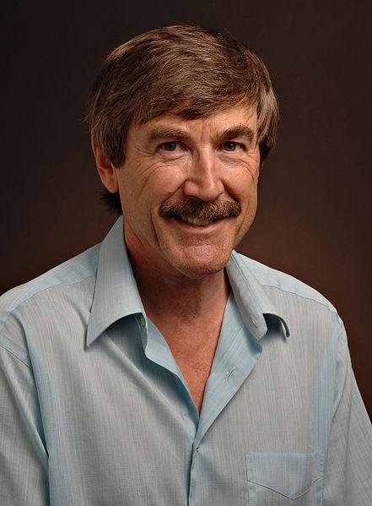
Paul Davies
Theoretical Physicist
“Scientists are slowly waking up to an inconvenient truth —the universe looks suspiciously like a fix. The issue concerns the very laws of nature themselves. For 40 years, physicists and cosmologists have been quietly collecting examples of all too convenient ‘coincidences’ and special features in the underlying laws of the universe that seem to be necessary in order for life, and
hence conscious beings, to exist."

Slide 26
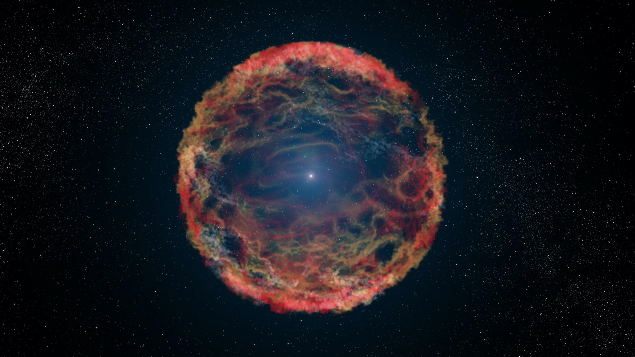
Gravity
&
The Big Bang

Slide 27
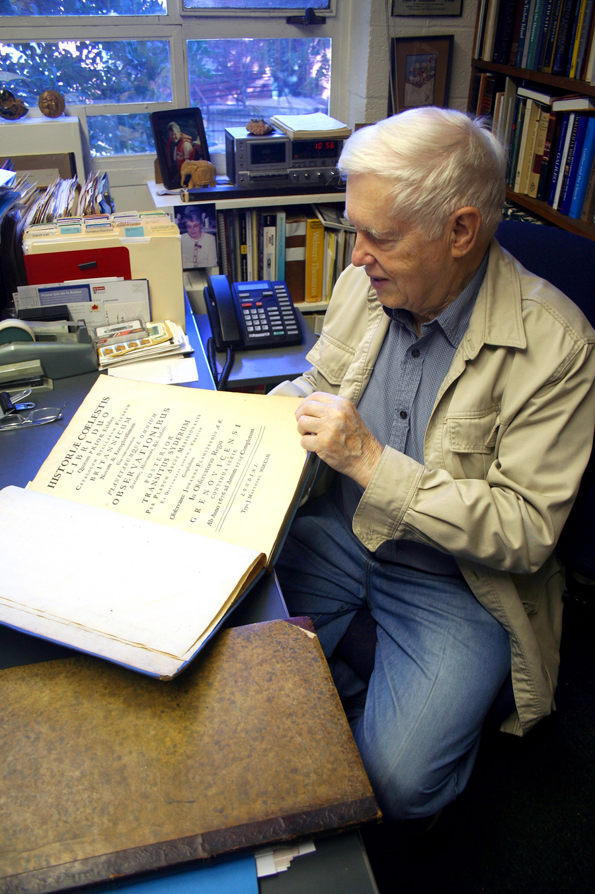
Owen Gingerich
God’s Universe
“The balance between the energy of expansion [i.e., the force of the explosion] and the braking power of gravitation had to be extraordinarily exact.”

Slide 28
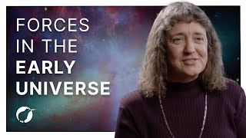

Slide 29
Dr. Chris Baglow, Faith, Science, and Reason
“This competition had to be very precisely balanced, otherwise one of two disasters would have happened. Had the gravitational attraction been too strong, it would have quickly halted then reversed the expansion, and the matter would have come crashing back together while the universe was still very tiny and new. On the other hand, had the gravity been too weak, the matter would have spread out much too quickly and stars and galaxies would not have been able to form. We would either have had no universe or one that would not support life.”

Slide 30
How precise did the temperature of the Big Bang explosion need to be to support a universe with life?

Slide 31
Dr. Chris Baglow, Faith, Science, and Reason
“For the Big Bang to happen in such a way that life as we know it could result, the ‘dial’ had to be set not to an accuracy of a hundredth of a degree, or a millionth, or even a billionth, but to thirty decimal places, that is, to 0.000000000000000000000000000001 of a degree. Otherwise, this ‘cake’ – this universe that was able to bring forth living things – would have been ruined. The balance necessary for our life-producing universe was so exact that it is unbelievably improbable. And yet exactly what needed to happen did happen.”

Slide 32
Strong Nuclear Force
&
the Elements of the Universe

Slide 33
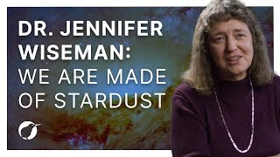

Slide 34
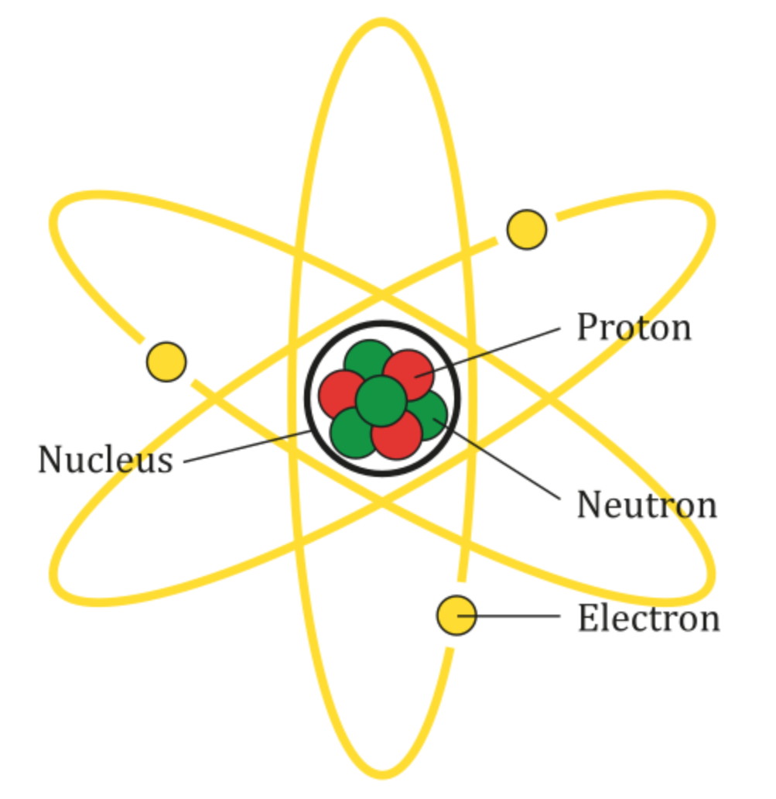
Strong Nuclear Force
The attractive force that causes protons and neutrons to stick together to form an atomic nucleus; it is the atomic force of atoms.
“Scientists [have] discovered that the strength of this force is… ‘fine-tuned’ in such a way as to make life possible. If it were only a few percent weaker, then protons and neutrons could not stick together; if it were only a few perfect stronger, then the fusion processes in stars would be able to happen in a completely different way that would allow them to burn hundreds of times faster than they do. In the first case, the building blocks of life would never have formed; in the second, the sun (and other stars) would have burned out so quickly that there would not have been time for living organisms to evolve. This force in us seems to be for us.”
- Christopher Baglow

Slide 35
Could all the
“anthropic coincidences” really just be coincidences?

Slide 36
“Let us go back to the oven analogy, except now let us imagine the laws of physics are like a device with a large number of switches, knobs, and dials that control various features of the universe. One switch would turn on and off the force of electromagnetism; one dial would set the strength of that force, another dial would control the control the mass of the electron, and so forth”

Slide 37
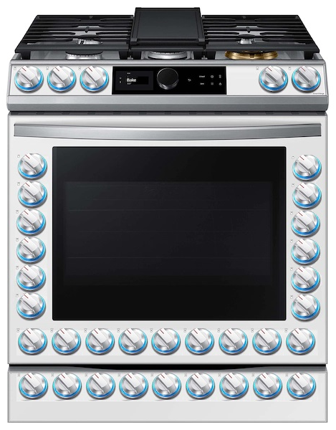
“If all those switches and dials have to be set to just the right positions–some of them to fantastic accuracy–in order for life to appear, and we indeed find them set that way, is that not pretty strong evidence for a Creator who had the intention of creating a world with life in it?”

Slide 38
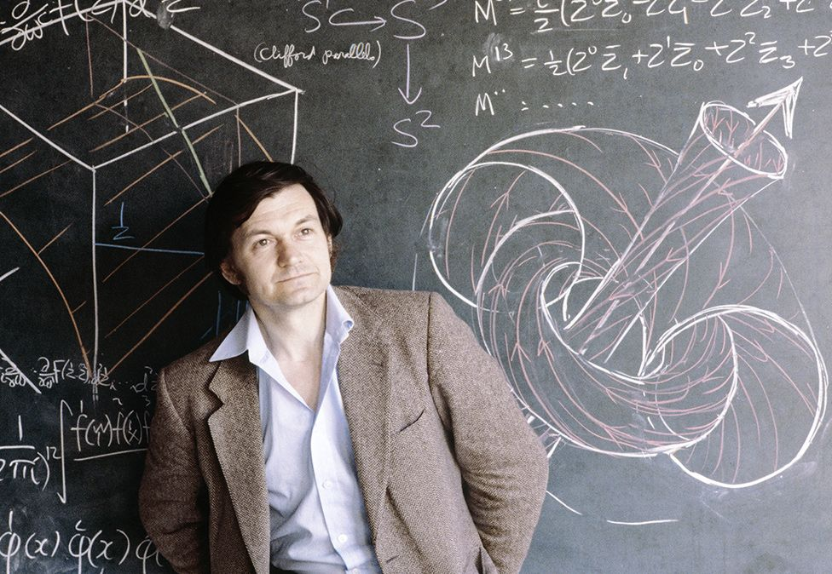
Roger Penrose
Mathematical Physicist
Oxford Scholar
This is an extraordinary figure. One could not possibly even write the number down in full in the ordinary…notation: it would be 1 followed by 10^123 successive 0’s. Even if we were to write a 0 on each separate proton and on each separate neutron in the entire universe–and we could throw in all the other particles for good measure–we should fall far short of writing down the figure needed.”

Slide 39
Class Discussion
Could all of the “anthropic coincidences” really just be coincidences?
Do anthropic coincidences constitute proof of the existence of God?
Many contemporary atheists assume that their position on the existence of God is argued from the logical high ground? How do the anthropic coincidences turn that assumption on its head?

Slide 40
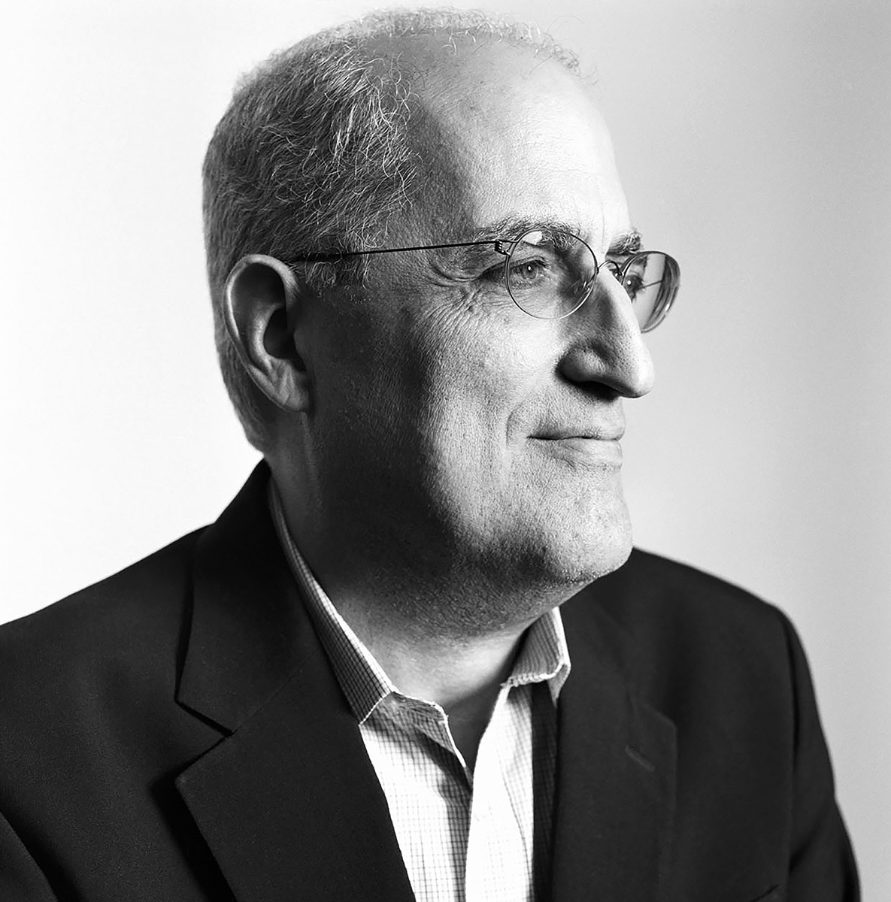
Edward Witten
Theoretical Physicist
“The laws of nature are very delicate. … [The fact] that galaxies, stars and planets roughly like ours could have formed, and that living things roughly like us could have formed depends on many details of the laws of physics as we currently know them being just the way they are and not being slightly different. [I think] we’ll never resolve the sense of wonder about that.”

Slide 41
Images
By Pablo Carlos Budassi - Own work, CC BY-SA 4.0, https://commons.wikimedia.org/w/index.php?curid=93329844
By Ryderthebard - Own work, CC BY-SA 4.0, https://commons.wikimedia.org/w/index.php?curid=127866788
ASU / Tom Story, Public domain, via Wikimedia Commons
By ESA/Hubble, CC BY 4.0, https://commons.wikimedia.org/w/index.php?curid=35306789
AG Caesar, CC BY-SA 4.0 <https://creativecommons.org/licenses/by-sa/4.0>, via Wikimedia Commons

