Slide 1
Catholic Anthropology
Formed by Our Senses: The Impact of Pornography
on the Individual, Relationships, and Society
Notes:
At this point, students have studied the harmful effects of pornography on the individual, on human relationships, and society at large from a scientific and sociological perspective. Hopefully students will already be thinking about how the Church might respond to the issue of pornography, and what reasons the Church might give for teaching that pornography is sinful and harmful to the human person. This lesson aims to give students a clear understanding of how the Church’s teaching on pornography is grounded in Catholic anthropology - the understanding of who the human person is, and what we were made for. This set of slides will lead students into the final assessment where they will be asked to respond to the prompt: Why is pornography harmful to the human person? For this final assessment, you will be asked to answer this question by developing an argument using academic research from “Fight the New Drug” and theological insights.

Slide 2
“The problem with pornography is not that it shows too much of the person, but that it shows far too little.”
Notes:
“The problem with pornography is not that it shows too much of the person, but that it shows far too little.” This is a provocative statement, and one that will likely grab students’ attention. After re-presenting the quote from their homework assignment the night before, the teacher should ask the students if they agree or disagree. After hearing a few responses from students, the teacher should reveal who this quote is attributed to: St. John Paul II. After revealing the source of the quote, the teacher might ask students if they are surprised that a saint would make a claim like this. The teacher can then ask, “Whether or not you agree with his statement, why do you think St. John Paul II makes this claim? What beliefs led him to make this statement?”

Slide 3
To understand this quote, we need to “get inside” the mind of St. John Paul II by learning about Catholic anthropology

Slide 4
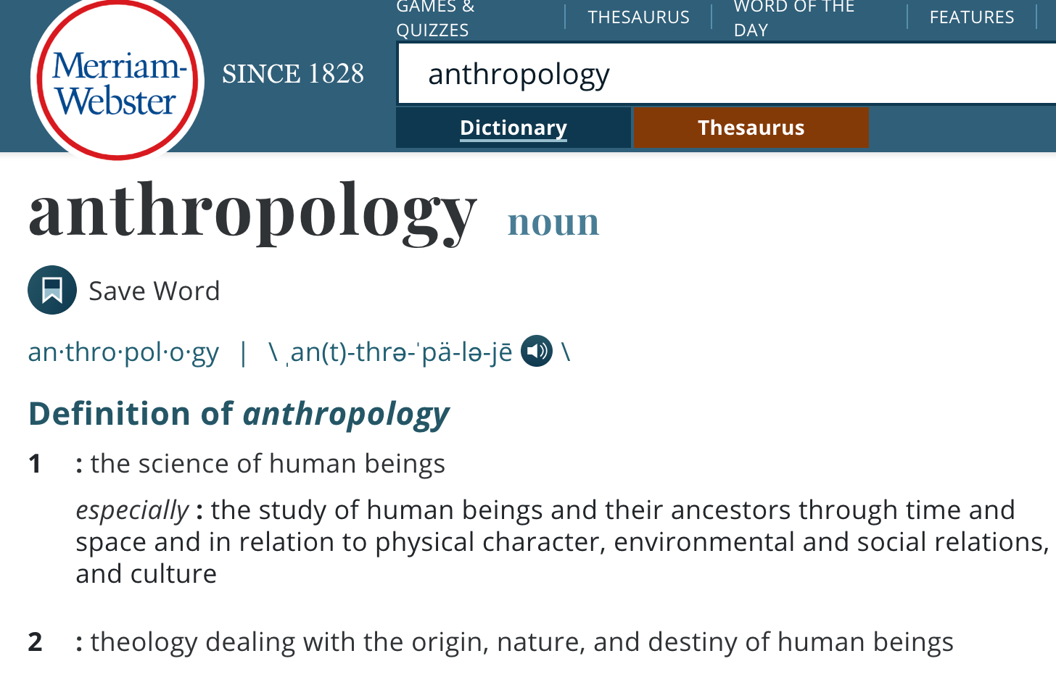
What is Anthropology?
Notes:
To understand the meaning of Catholic anthropology, we first have to define anthropology. Anthropology is defined as “the science of human beings.” Science studies reality through observation, so anthropology is studying human beings through observation. To be more specific, anthropology is “the study of human beings…through time and space and in relation to physical character, environmental and social relations, and culture.”
After explaining this, the teacher may ask the students, “Given this definition, what kinds of things might you study if you wanted to study the anthropology of your family, school, or sports team?”
The teacher may follow this up by asking the students what they learn about their particular group in studying them. At this point, the teacher can bring in the concept of a “worldview.” By studying human individuals or groups, their lives in relation to their environment and others, we can come to understand, at least in part, how a person views and “makes sense of” the world around them, what they value, how they see themselves, etc. We can understand their worldview. (A worldview is like a pair of glasses we might wear - it is the lens through which we see and understand the world around us.) The teacher can prompt this line of thinking by asking “why” questions like:
Clare, you mentioned that everyone in your family plays an instrument, why do you think this is the case? Why is it important for your family to spend time learning an instrument?
Tommy, you mentioned that your group of friends volunteers to make meals for the homeless. Why is it important for your friends to spend time doing this?
Jackson, you said that you and your siblings are in charge of washing the dishes and cleaning the bathroom at home. Why? Why is it important for you to spend your time helping around the house?
The second definition for anthropology is “theology dealing with the origin, nature, and destiny of human beings.” Catholic anthropology widens our worldview to see more than just the material world. It allows us to see the meaning and purpose of the material world and informs our understanding of what it means to be a human person.

Slide 5
What is Catholic Anthropology?
A way of responding to the question, “What does it mean to be a human person?” by studying:
The human person in the context of the created world
What Scripture reveals about human nature
What the teachings of the Church (Sacred Tradition) reveal about human nature
Notes:
Catholic anthropology answers the question, “What does it mean to be a human person?” by studying the person in the context of the created world, what Scripture reveals about human nature, and what the teachings of the Church (Sacred Tradition) reveal about human nature.
Students may remember the concept of “Natural Revelation”* from previous theology classes. This refers to what we can know about God based on observations of the natural world. An idea that might be helpful for some students to latch onto is that you can know about the creator by what they create. For example, when we notice the numerical patterns present in nature (such as the Fibonacci sequence), we become aware that God creates with a sense of order. Another example we might observe is that human beings exercise control over other species of animals. This tells us that God gives human beings a unique responsibility to be stewards of the earth and its creatures. This is also revealed in Scripture, especially in the book of Genesis, where God grants Adam “dominion” over the rest of creation.
The teachings of the Church, also known as Sacred Tradition, help us understand and interpret what is revealed by God through the created world and through Scripture.
* Natural Revelation is covered in the first unit of The Revelation of Jesus Christ in Scripture, the first course listed in the USCCB’s “Doctrinal Elements of a Curriculum Framework for the Development of Catechetical Materials for Young People of High School Age.” For more on Natural Revelation, see Catechism of the Catholic Church #31-35.

Slide 6
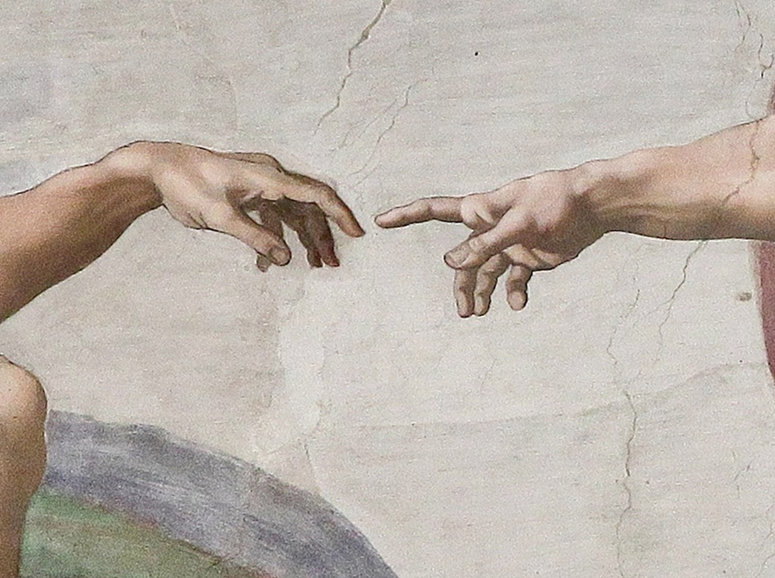
Top 3 Takeaways of Catholic Anthropology
Human beings are made for intimate relationship with God and others.
There is a unity between body and soul.
Sexual intimacy represents a complete gift of self, both body and soul.
Notes:
The teacher will introduce these three takeaways of Catholic anthropology: (1) Human beings are made for intimate relationship with God and others, (2) There is unity between body and soul, and (3) Sexual intimacy represents a complete gift of self, both body and soul. These three principles will guide the rest of the presentation.

Slide 7
Top 3 Takeaways of Catholic Anthropology
Human beings are made for intimate relationship with God and others.
There is a unity between body and soul.
Sexual intimacy represents a complete gift of self, both body and soul.
Notes:
The teacher will introduce the first of the three principles. Before moving onto the next slide, the teacher should ask students, “How does this idea that human beings are made for intimate relationship connect with what we learned in the last lesson? How does science support this idea?” Students should recall from the “Fight the New Drug” videos that the human brain is wired for connection.

Slide 8
The Human Person as Imago Dei
To be human is to be made in the image and likeness of God (Imago Dei).
“Then God said: Let us make human beings in our image, after our likeness… God created mankind in his image; in the image of God he created them; male and female he created them” (Gen. 1: 26-27).
The Trinity is the intimate communion of Father, Son and Holy Spirit
  We are made for intimate relationship with God and others
Notes:
Depending on the prior knowledge of the students, the teacher may need to refresh students on the Catholic understanding of Scripture, especially the Genesis narratives. The Understanding Scripture segment of the instructional guide provides starting points for a refresher on the Catholic understanding of Scripture.
After establishing a Catholic understanding of Scripture with particular regard for the book of Genesis, the teacher should have the students read the passage on the slide. Ask the students, “What do you notice about this passage? Is there anything strange about the wording?” Students will likely notice the change in pronouns that occurs between verses 26 and 27. If not, the teacher should point out the discrepancy in pronouns within these verses. The passage begins with the plural and moves to the singular. This may indicate the Trinitarian nature of one God in three persons. Because the Trinity is the intimate communion of Father, Son and Holy Spirit and we are made in the image of the Trinity, we are also made for intimate relationship with God and others.

Slide 9
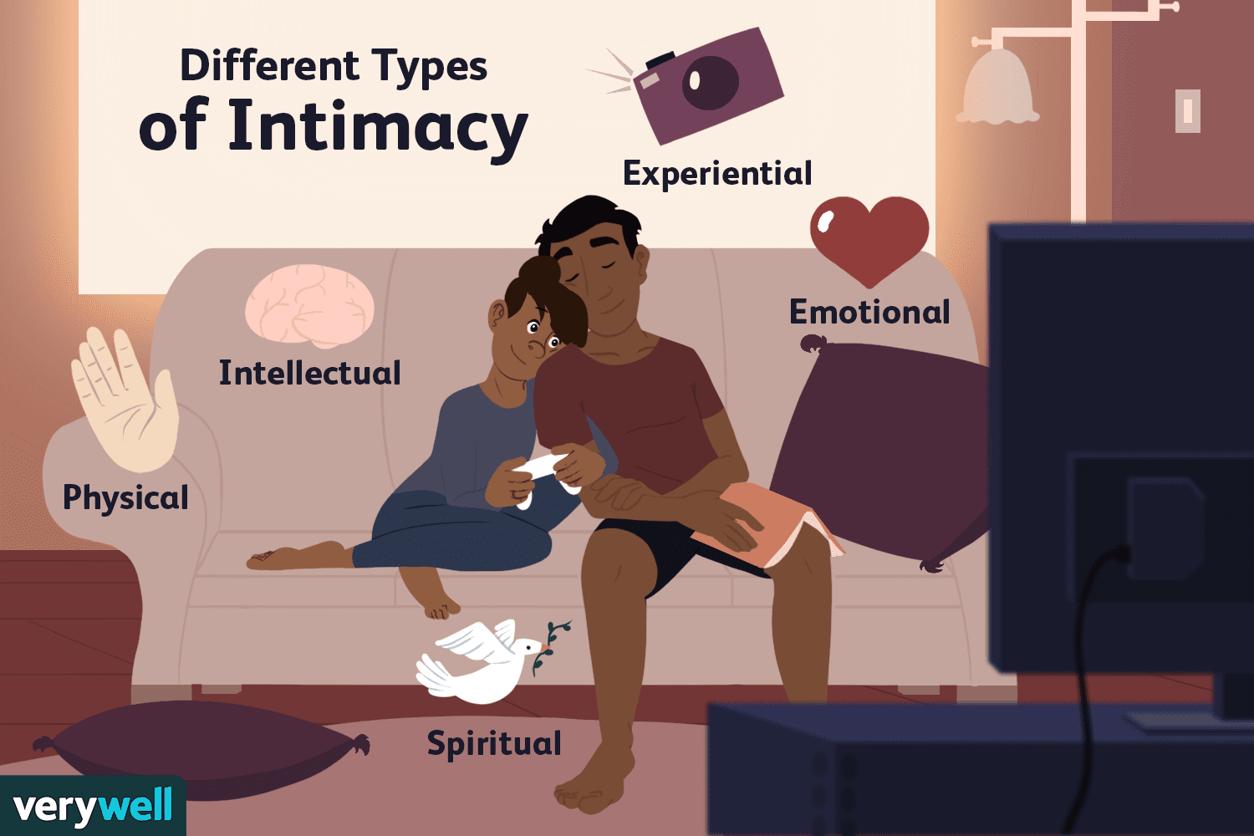
What is Intimacy?
Intimacy refers to familiarity or closeness in relationship
Different kinds of intimacy:
Spiritual
Emotional
Intellectual
Experiential
Physical
Sexual
Notes:
While students are sure to be familiar with the term ‘intimacy,’ they may not have considered the full meaning of the word. It will be important for the teacher to emphasize that sexual intimacy is just one manifestation of intimacy. There are many non-sexual ways to develop familiarity or closeness with another person. The teacher could consider asking students for examples of activities that would foster the different kinds of intimacy. For example, a family might pray before meals together to foster spiritual intimacy. A couple might discuss a book together to foster intellectual intimacy. A mother might rock her son to sleep to foster physical intimacy.

Slide 10

Sexual Intimacy
In a healthy marriage, sexual intimacy is present alongside the other dimensions of intimacy.
Sexual intimacy involves a full gift of self to the other.
This requires vulnerability, knowledge of one’s authentic self, and the ability to recognize one’s spouse as gift and mystery.
Notes:
Once students have had a chance to discuss non-sexual intimacy, the teacher will explain the role of sexual intimacy in the context of a healthy marriage. While sexual intimacy is a critical part of the marital relationship, it is meant to exist alongside the many other manifestations of intimacy. True intimacy requires vulnerability, knowledge of one’s authentic self, and the ability to recognize one’s spouse as a gift and mystery.

Slide 11
Given what we’ve learned so far, why do you think pornography might be considered an illusion of intimacy?
Notes:
At this point, students should have enough knowledge to begin to see some of the problems with pornography, particularly in light of intimacy with God and others. Student responses might include…
Pornography is a distortion of intimacy because it portrays sexual intimacy without any other type of intimacy.
It gives a one-dimensional view of intimacy that ignores the human need for other dimensions of intimacy.
Pornography provides only an illusion of intimacy, since there is no real relationship between the persons on the screen and the consumer.

Slide 12

Illusions of Intimacy
Pornography tries to present sexual intimacy as the only dimension of intimacy.
This gives a one-dimensional view of intimacy that ignores the human need for the other types of intimacy.
Pornography provides only an illusion of intimacy, since there is no real relationship between the persons on the screen and the consumer.
Notes:
Pornography is a distortion of intimacy because it portrays sexual intimacy without any other type of intimacy. It gives a one-dimensional view of intimacy that ignores the human need for other dimensions of intimacy. Pornography provides only an illusion of intimacy, since there is no real relationship between the persons on the screen and the consumer.
End of Day 1

Slide 13
Quick Review
Answer these questions based on what you remember from our last class
What is anthropology?
What are we studying when we explore Catholic anthropology?
The first takeaway of Catholic anthropology was, “Human beings are made for intimate relationship with God and others.” Why is pornography an illusion of intimacy?
Notes:
Start of Day 2
The teacher will begin by asking students to answer the questions on this slide. After giving students a few seconds to think about the questions on their own, the teacher can ask for volunteers to share their responses with the class. These questions will give the students an opportunity to recall the material of the previous class. The teacher may also invite students to ask any clarifying questions they may have about the previous day’s material.
What is anthropology?
Studying human beings through observation. It can also involve studying the origin, nature, and destiny of human beings.
What are we studying when we explore Catholic anthropology?
Catholic anthropology explores human nature through the lenses of nature, Scripture, and the teachings of the Church.
The first takeaway of Catholic anthropology was, “Human beings are made for intimate relationship with God and others.” Why is pornography an illusion of intimacy?
Pornography is an illusion of intimacy because it may provide pleasurable feelings similar to the feelings that come from real physical intimacy, but there is no real relationship between the people on the screen and the consumer.

Slide 14
Top 3 Takeaways of Catholic Anthropology
Human beings are made for intimate relationship with God and others.
There is a unity between body and soul.
Sexual intimacy represents a complete gift of self, both body and soul.
Notes:
Here the teacher introduces the second of the three principles. This idea will be explained in-depth in later slides, but at this point it might be beneficial for the teacher to ask students if they have heard of this idea before and if so, what it means to them.

Slide 15
The Human Person as Body and Soul
“Then the LORD God formed the man out of the dust of the ground and blew into his nostrils the breath of life, and the man became a living being” (Gen. 2: 7).
“God formed the man out of the dust of the ground”
  Indicates the bodily formation of the human person
“[God] blew into his nostrils the breath of life”
  Indicates the creation of the soul
Notes:
After reading the Genesis passage, the teacher should help the students break the passage into two parts:
1. “God formed the man out of the dust of the ground” - indicates the bodily formation of the human person
2. “[God] blew into his nostrils the breath of life” - indicates the creation of the soul
We spoke previously in this unit about our bodily senses, and the ways in which the environment around us can impact us. We experience the world in a significant way through our bodies. Though the soul is not something we can see with our eyes, there are rational arguments for the existence of the human soul. The human person’s ability to reason and make free choices is one of the clearest indications of the existence of the soul. This will be discussed on the next slide.

Slide 16
The Human Person as Body and Soul
“Then the LORD God formed the man out of the dust of the ground and blew into his nostrils the breath of life, and the man became a living being” (Gen. 2: 7).
“God formed the man out of the dust of the ground”
  Indicates the bodily formation of the human person
“[God] blew into his nostrils the breath of life”
  Indicates the creation of the soul
Notes:
After reading the Genesis passage, the teacher should help the students break the passage into two parts:
1. “God formed the man out of the dust of the ground” - indicates the bodily formation of the human person
2. “[God] blew into his nostrils the breath of life” - indicates the creation of the soul
We spoke previously in this unit about our bodily senses, and the ways in which the environment around us can impact us. We experience the world in a significant way through our bodies. Though the soul is not something we can see with our eyes, there are rational arguments for the existence of the human soul. The human person’s ability to reason and make free choices is one of the clearest indications of the existence of the soul. This will be discussed on the next slide.

Slide 17
The Human Person as Body and Soul
“Then the LORD God formed the man out of the dust of the ground and blew into his nostrils the breath of life, and the man became a living being” (Gen. 2: 7).
“God formed the man out of the dust of the ground”
  Indicates the bodily formation of the human person
“[God] blew into his nostrils the breath of life”
  Indicates the creation of the soul
Notes:
After reading the Genesis passage, the teacher should help the students break the passage into two parts:
1. “God formed the man out of the dust of the ground” - indicates the bodily formation of the human person
2. “[God] blew into his nostrils the breath of life” - indicates the creation of the soul
We spoke previously in this unit about our bodily senses, and the ways in which the environment around us can impact us. We experience the world in a significant way through our bodies. Though the soul is not something we can see with our eyes, there are rational arguments for the existence of the human soul. The human person’s ability to reason and make free choices is one of the clearest indications of the existence of the soul. This will be discussed on the next slide.

Slide 18
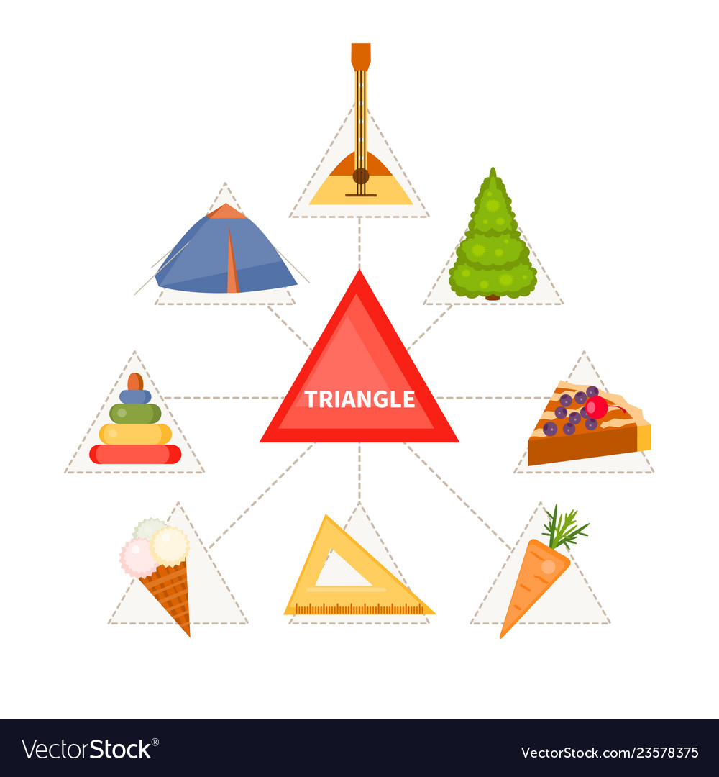
The Soul
The soul provides human beings with rationality and will
Rationality: allows us to conceptualize what we take in through our senses
  Ex: Conceptualizing ‘triangle’ based on observing many triangular objects
Will: allows us to make free choices
  Ex: Choosing to eat a cheeseburger for lunch (free choice) vs. digesting my food (not an act of the will)
Notes:
Most students will be familiar with the concept of the soul, but they may not have thought very much about what our souls allow us to do. One of the powers of the soul is rationality, which allows us to conceptualize what we take in through our senses. For example, we understand the concept of ‘triangle’ by seeing and touching many different triangular objects (a slide of pizza, a piece of pie, etc.).
Rationality sets human beings apart from other animals, whose scope of understanding is limited to what they can take in through their senses. As human beings with rationality, we are able to take in information through our senses and conceptualize based on those sense experiences. For example, I could see and touch many different triangular objects (a slice of pizza, a piece of pie, a tortilla chip, etc.) and come to an understanding of the abstract concept of a triangle (adapted from Dr. Melissa Moschella, “Philosophical and Theological Foundations of Human Dignity,” Teaching Human Dignity Symposium, 2022).
The soul also provides human beings with a will. The will allows us to make free choices. An example of this would be choosing to eat a cheeseburger for lunch instead of a peanut butter sandwich. Both are available to me, but I choose one over the other. This kind of action involves the will. In contrast, digesting my lunch is not an act of the will. It will happen even if I don’t think about it (adapted from Dr. Melissa Moschella, “Philosophical and Theological Foundations of Human Dignity,” Teaching Human Dignity Symposium, 2022).

Slide 19
The Soul
The soul provides human beings with rationality and will
Rationality: allows us to conceptualize what we take in through our senses
  Ex: Conceptualizing ‘triangle’ based on observing many triangular objects
Will: allows us to make free choices
  Ex: Choosing to eat a cheeseburger for lunch (free choice) vs. digesting my food (not an act of the will)
Notes:
Most students will be familiar with the concept of the soul, but they may not have thought very much about what our souls allow us to do. One of the powers of the soul is rationality, which allows us to conceptualize what we take in through our senses. For example, we understand the concept of ‘triangle’ by seeing and touching many different triangular objects (a slide of pizza, a piece of pie, etc.).
Rationality sets human beings apart from other animals, whose scope of understanding is limited to what they can take in through their senses. As human beings with rationality, we are able to take in information through our senses and conceptualize based on those sense experiences. For example, I could see and touch many different triangular objects (a slice of pizza, a piece of pie, a tortilla chip, etc.) and come to an understanding of the abstract concept of a triangle (adapted from Dr. Melissa Moschella, “Philosophical and Theological Foundations of Human Dignity,” Teaching Human Dignity Symposium, 2022).
The soul also provides human beings with a will. The will allows us to make free choices. An example of this would be choosing to eat a cheeseburger for lunch instead of a peanut butter sandwich. Both are available to me, but I choose one over the other. This kind of action involves the will. In contrast, digesting my lunch is not an act of the will. It will happen even if I don’t think about it (adapted from Dr. Melissa Moschella, “Philosophical and Theological Foundations of Human Dignity,” Teaching Human Dignity Symposium, 2022).

Slide 20
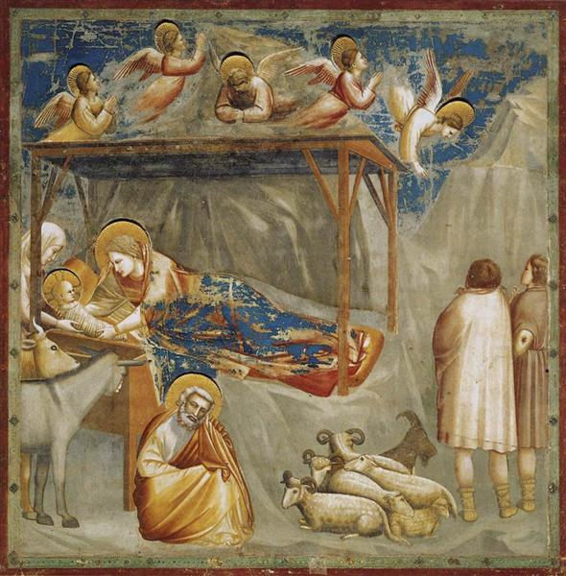
The Body
“The soul...is not an entire man, and I am not my soul.”
St. Thomas Aquinas
The body is essential to a person’s identity
The dignity of the body is fully revealed through the Incarnation
  God considers the body so good that He chooses to take on human flesh in Jesus Christ
Notes:
To be a human person is to be a union of body and soul. Often, there is a temptation to downplay the role of the body and to think that the only thing that matters is the soul, but this is not the case. “In the words of St. Thomas Aquinas, ‘The soul...is not an entire man, and I am not my soul.’ St. Thomas will not even call a soul without a body a person in the proper sense, for to be a living human person is to be both body and soul. This means that bodiliness is essential to being human” (Baglow, Faith, Science and Reason, 247).
The dignity of the body is fully revealed through the Incarnation. God considers the body so good that He chooses to take on human flesh in Jesus Christ (adapted from Dr. Melissa Moschella, “Philosophical and Theological Foundations of Human Dignity,” Teaching Human Dignity Symposium, 2022). This shows how important and sacred the body is, and what we do with our body really matters. In 1 Corinthians 6:19, St. Paul even says that the body is a “temple of the Holy Spirit”!

Slide 21
Unity of Body and Soul
Both Catholic doctrine and natural reason suggest that there is a unity of body and soul. What happens to my body affects my soul, and vice versa.
In his teaching known as “Theology of the Body,” St. John Paul II speaks of the “language of the body.”
  Language of the Body: The idea that bodily gestures carry meaning
    A person’s intentions should match the meaning conveyed by their bodily actions, but this is not always the case.
    Ex: If I shake someone’s hand but I actually hate them, there’s a contradiction there. This would be an example of “telling a lie” through the body.
Notes:
In his teaching known as “Theology of the Body,” St. John Paul II uses the term, ‘language of the body.’ This refers to the idea that our bodily gestures carry meaning (Ex: handshakes, kneeling, holding your hand up). Ideally, a person’s intentions will match the meaning conveyed by their bodily actions, but we know that this is not always the case. For example, If I shake someone’s hand in a social setting but I actually hate them, there’s a contradiction there. This would be an example of “telling a lie” through my body. When we fail to tell the truth with our bodies, we often frustrate ourselves and end up hurting others. This frustration we feel is a sign to us that our bodies and souls are meant to work in union with one another. The meaning of our bodily actions is meant to match the intentions of our souls.

Slide 22
Unity of Body and Soul
Both Catholic doctrine and natural reason suggest that there is a unity of body and soul. What happens to my body affects my soul, and vice versa.
In his teaching known as “Theology of the Body,” St. John Paul II speaks of the “language of the body.”
  Language of the Body: The idea that bodily gestures carry meaning
    A person’s intentions should match the meaning conveyed by their bodily actions, but this is not always the case.
    Ex: If I shake someone’s hand but I actually hate them, there’s a contradiction there. This would be an example of “telling a lie” through the body.
Notes:
In his teaching known as “Theology of the Body,” St. John Paul II uses the term, ‘language of the body.’ This refers to the idea that our bodily gestures carry meaning (Ex: handshakes, kneeling, holding your hand up). Ideally, a person’s intentions will match the meaning conveyed by their bodily actions, but we know that this is not always the case. For example, If I shake someone’s hand in a social setting but I actually hate them, there’s a contradiction there. This would be an example of “telling a lie” through my body. When we fail to tell the truth with our bodies, we often frustrate ourselves and end up hurting others. This frustration we feel is a sign to us that our bodies and souls are meant to work in union with one another. The meaning of our bodily actions is meant to match the intentions of our souls.

Slide 23
How does pornography deny the unity between the body and the soul?
Notes:
At this point, the teacher should invite students to discuss the question on this slide. Responses might include…
Pornography has individuals engage in intimate bodily actions without any commitment or connection to one another
Pornography presents the bodies of people engaging in sexual activity, but the viewers know nothing else about who those people are as persons/individuals

Slide 24
Top 3 Takeaways of Catholic Anthropology
Human beings are made for intimate relationship with God and others.
There is a unity between body and soul.
Sexual intimacy represents a complete gift of self, both body and soul.
Notes:
This final principle will bring together the two previous principles. Here is another opportunity for the teacher to relate this new material with material from the previous lesson. The teacher may ask, “Given what you’ve already learned, why is it important to see sexual intimacy as a serious, meaningful act? What can go wrong when sexual intimacy is trivialized through pornography?” Students will recall from the previous lesson that pornography use contributes to sexual violence and is connected to sex trafficking and sexual coercion. Trivializing sex can lead to real degredation of human beings.

Slide 25
Made for Love
The LORD God said: It is not good for the man to be alone. I will make a helper suited to him…The man gave names to all the tame animals, all the birds of the air, and all the wild animals; but none proved to be a helper suited to the man. So the LORD God cast a deep sleep on the man, and while he was asleep, he took out one of his ribs and closed up its place with flesh. The LORD God then built the rib that he had taken from the man into a woman. When he brought her to the man, the man said: “This one, at last, is bone of my bones and flesh of my flesh; This one shall be called ‘woman,’for out of man this one has been taken.” That is why a man leaves his father and mother and clings to his wife, and the two of them become one body. The man and his wife were both naked, yet they felt no shame. (Gen. 2:18-25).
Notes:
The teacher will read the passage from Genesis 2, or ask a student to read. Emphasis should be placed on the bolded section: “This one, at last, is bone of my bones and flesh of my flesh.” This indicates the fact that Adam and Eve are specifically designed for one another. They are meant to receive one another as gifts.

Slide 26
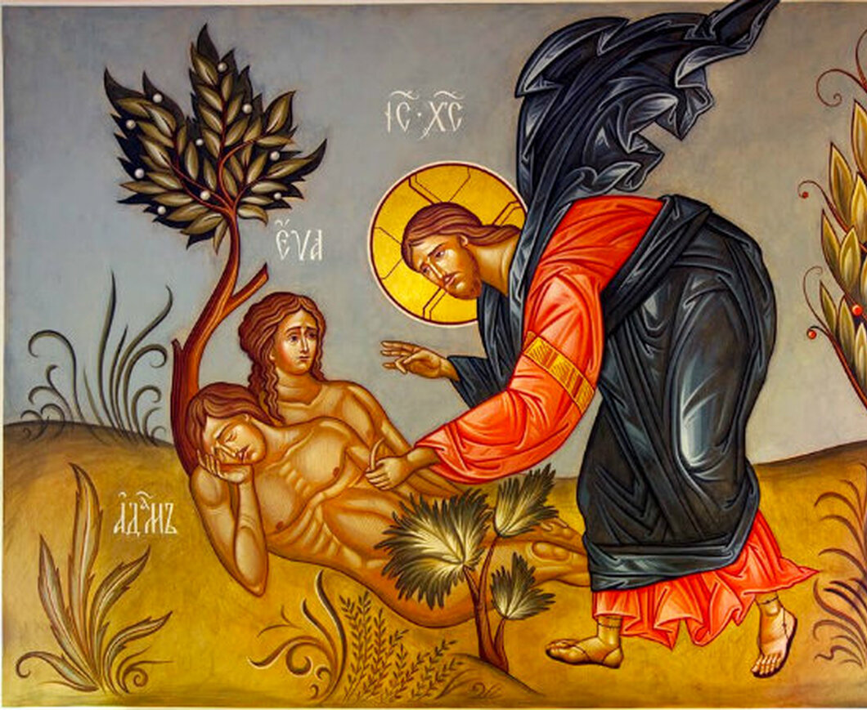
Made for Love
Adam and Eve are designed to receive one another as gifts
  They do not just receive one another’s bodies, but they receive one another as whole persons, both body and soul.
This shows that authentic love is to will the good of the whole person, both body and soul. This is the kind of love we are made for.
Notes:
Adam and Eve receive one another as gifts. They do not just receive one another’s bodies, but they receive one another as whole persons, both body and soul. When we receive a great gift, we want to give something in return. When we receive the gift of a whole person, we want to give our whole selves in return. This is where we see the meaning of authentic love - to will the good of the whole person, both body and soul. If we think back to the beginning of this lesson and the fact that we are made in the image of the Trinity, it becomes clear that we are made for this kind of total, self-giving love.

Slide 27
Embodied Love
Since there is a unity between the soul and body, our intentions should match the meaning conveyed by our bodily gestures.
As a physical gesture, sexual intercourse carries a particular meaning: it bonds a couple and has the potential to bring about new life.
In marriage, a husband and wife declare their intention to be faithful to one another and welcome children into their lives.
For a married couple engaging in sexual intercourse, the meaning conveyed through their action matches their intentions. They are “telling the truth” through the language of the body.
Notes:
The teacher will remind students that since there is a unity between the soul and body, our intentions should match the meaning conveyed by our bodily gestures.
For a married couple engaging in sexual intercourse that is loving (not lustful) and open to the potential of life, the meaning conveyed through their action matches their intentions. They are “telling the truth” through the language of the body. Here, it will also be helpful to provide counterexamples. One example could be a man who enters into a sexual relationship with a woman, but intends to leave her if they conceive a child. In this case, the meaning of sexual intercourse (bonding, procreation) does not match the intention of the man, who may wish to bond with his partner, but only in a temporary way, and who has no desire to parent a child. Another (more trivial) example would be a student who raises her hand after her teacher asks a question, but once she is called on remains silent. The meaning of her action (raising her hand to answer a question) does not match her intention (to remain silent).

Slide 28
Embodied Love
Since there is a unity between the soul and body, our intentions should match the meaning conveyed by our bodily gestures.
As a physical gesture, sexual intercourse carries a particular meaning: it bonds a couple and has the potential to bring about new life.
In marriage, a husband and wife declare their intention to be faithful to one another and welcome children into their lives.
For a married couple engaging in sexual intercourse, the meaning conveyed through their action matches their intentions. They are “telling the truth” through the language of the body.
Notes:
The teacher will remind students that since there is a unity between the soul and body, our intentions should match the meaning conveyed by our bodily gestures.
For a married couple engaging in sexual intercourse that is loving (not lustful) and open to the potential of life, the meaning conveyed through their action matches their intentions. They are “telling the truth” through the language of the body. Here, it will also be helpful to provide counterexamples. One example could be a man who enters into a sexual relationship with a woman, but intends to leave her if they conceive a child. In this case, the meaning of sexual intercourse (bonding, procreation) does not match the intention of the man, who may wish to bond with his partner, but only in a temporary way, and who has no desire to parent a child. Another (more trivial) example would be a student who raises her hand after her teacher asks a question, but once she is called on remains silent. The meaning of her action (raising her hand to answer a question) does not match her intention (to remain silent).

Slide 29
Embodied Love
Since there is a unity between the soul and body, our intentions should match the meaning conveyed by our bodily gestures.
As a physical gesture, sexual intercourse carries a particular meaning: it bonds a couple and has the potential to bring about new life.
In marriage, a husband and wife declare their intention to be faithful to one another and welcome children into their lives.
For a married couple engaging in sexual intercourse, the meaning conveyed through their action matches their intentions. They are “telling the truth” through the language of the body.
Notes:
The teacher will remind students that since there is a unity between the soul and body, our intentions should match the meaning conveyed by our bodily gestures.
For a married couple engaging in sexual intercourse that is loving (not lustful) and open to the potential of life, the meaning conveyed through their action matches their intentions. They are “telling the truth” through the language of the body. Here, it will also be helpful to provide counterexamples. One example could be a man who enters into a sexual relationship with a woman, but intends to leave her if they conceive a child. In this case, the meaning of sexual intercourse (bonding, procreation) does not match the intention of the man, who may wish to bond with his partner, but only in a temporary way, and who has no desire to parent a child. Another (more trivial) example would be a student who raises her hand after her teacher asks a question, but once she is called on remains silent. The meaning of her action (raising her hand to answer a question) does not match her intention (to remain silent).

Slide 30
Embodied Love
Since there is a unity between the soul and body, our intentions should match the meaning conveyed by our bodily gestures.
As a physical gesture, sexual intercourse carries a particular meaning: it bonds a couple and has the potential to bring about new life.
In marriage, a husband and wife declare their intention to be faithful to one another and welcome children into their lives.
For a married couple engaging in sexual intercourse, the meaning conveyed through their action matches their intentions. They are “telling the truth” through the language of the body.
Notes:
The teacher will remind students that since there is a unity between the soul and body, our intentions should match the meaning conveyed by our bodily gestures.
For a married couple engaging in sexual intercourse that is loving (not lustful) and open to the potential of life, the meaning conveyed through their action matches their intentions. They are “telling the truth” through the language of the body. Here, it will also be helpful to provide counterexamples. One example could be a man who enters into a sexual relationship with a woman, but intends to leave her if they conceive a child. In this case, the meaning of sexual intercourse (bonding, procreation) does not match the intention of the man, who may wish to bond with his partner, but only in a temporary way, and who has no desire to parent a child. Another (more trivial) example would be a student who raises her hand after her teacher asks a question, but once she is called on remains silent. The meaning of her action (raising her hand to answer a question) does not match her intention (to remain silent).

Slide 31

Embodied Love
For the married couple, sex represents:
A complete gift of self
A reverent receiving of the spouse, both in body and soul
A willingness to sacrifice for the good of the spouse (and children that come from their union)
Notes:
This slide expands on the meaning of sexual intercourse in the context of sacramental marriage. The teacher should take care to acknowledge that not all marriages live up to this ideal all the time, and that sex can become lustful and/or used to manipulate and abuse even within the context of marriage. The tragic nature of that reality makes it even more important to discuss what sex is meant to represent in the context of marriage.

Slide 32
When someone is viewing pornography what do they NOT know about the person they’re viewing on the screen?
Notes:
The teacher should ask students to respond to the question on the slide. Students responses may include…
What the person’s life is like off-screen
Whether the persons are engaging in sexual acts consensually
The point to emphasize here is that pornography is completely disconnected from real relationship and fails to foster true intimacy.

Slide 33

Embodied Exploitation
While authentic love honors the whole person (body and soul) pornography reduces a person to their body alone.
Pornography leaves no room for sacrifice. Instead, it suggests that sex is only about pleasure, and that persons are valuable only for the sexual gratification they can provide the viewer through exploitation.
Notes:
While authentic love honors the whole person (body and soul) pornography reduces a person to their body alone. Pornography leaves no room for sacrifice. Instead, it suggests that sex is only about pleasure, and that persons are valuable only for the sexual gratification they can provide for the viewer. While pornography can create the illusion of sexual intimacy, it is ultimately unsatisfying because there is no real relationship fostered. Often, the people represented in pornographic materials are forced into these activities as a result of sex trafficking and other forms of sexual exploitation.

Slide 34
What Pornography Fails to Provide
The stories, emotions, and life experiences of the persons engaging in sexual activity
The personal communion formed between spouses
The joy that is found in giving oneself as a gift to another
The security and validation that comes from being fully known and loved by another person
While pornography can provide the viewer sexual pleasure, it fails to provide real intimacy, which is often the very desire that leads someone to seek out pornography in the first place.
Notes:
After going through each of the points on the slide, the teacher should point out that all four of these points are examples of intimacy. While pornography can provide the viewer sexual pleasure, it fails to provide real intimacy, which is often the very desire that leads someone to seek out pornography in the first place.

Slide 35
“The problem with pornography is not that it shows too much of the person, but that it shows far too little.”
Pope St. John Paul II
Notes:
At this point, the teacher should ask students, “What do you think about this quote now? Given what we’ve learned, what do you think St. John Paul II meant by this?” This discussion will help them prepare to answer their final assessment question.

