Slide 1
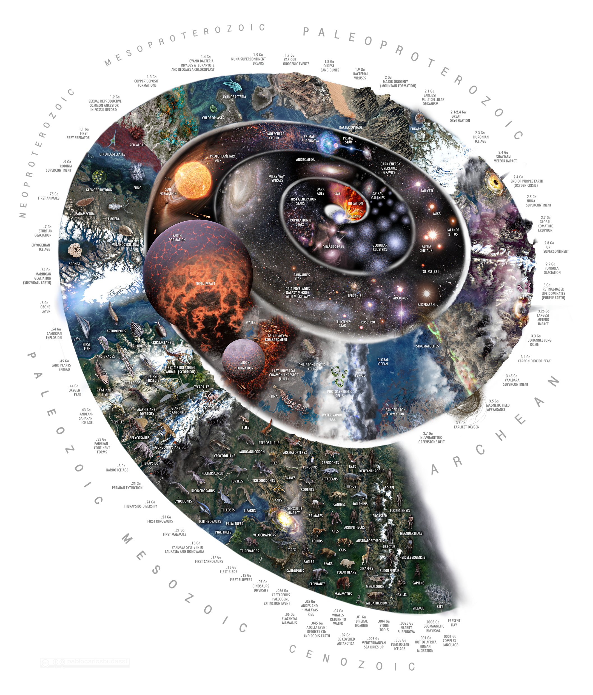
Exploring Geologic Time
Image Credit: Paul Carlos Budassi. This file is licensed under the Creative Commons Attribution-Share Alike 4.0 International license.

Slide 2
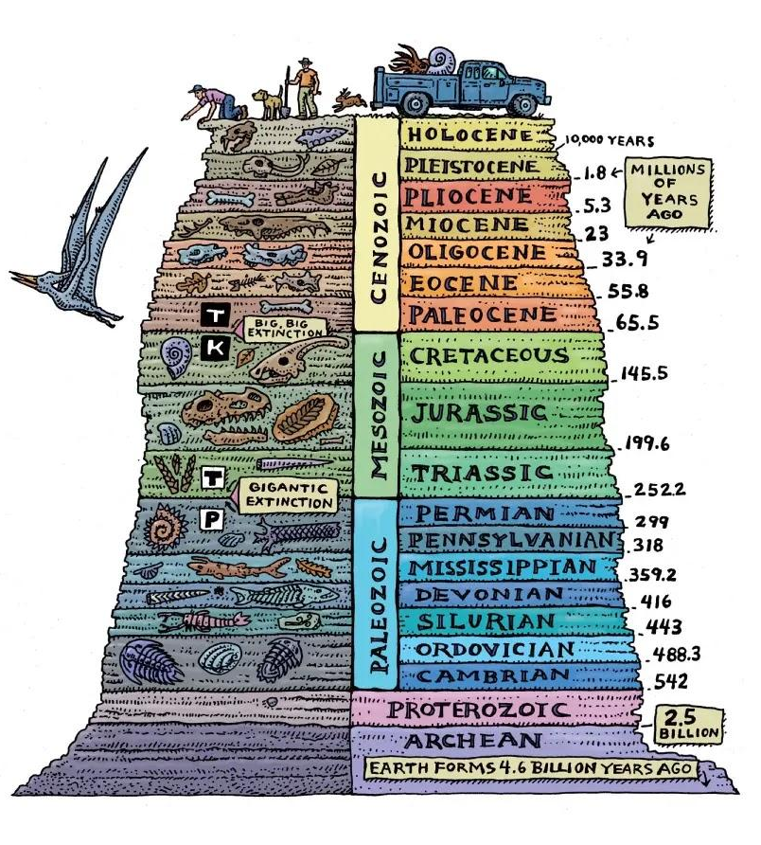
Objectives of Presentation
To outline the history of how we understand geologic time
To describe how the geologic time scale is organized
Image Credit: Ray Troll

Slide 3
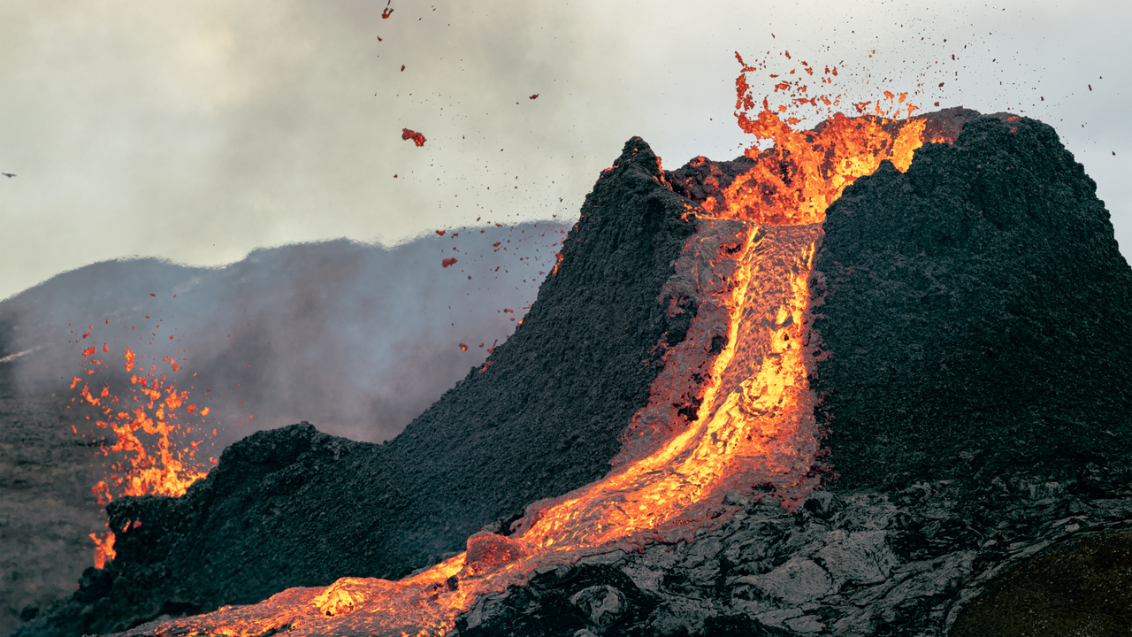
What is Geologic Time?
The events of earth history through time as they relate to the rocks that make up our planet
Each rock on the earth formed at a particular time and place
https://news.unm.edu/news/volcanic-eruption-scientists-perform-volcanic-scenarios-to-develop-response-plan
https://news.uga.edu/uga-study-extinction-risk-not-always-safety-in-numbers-050812/
Notes:
Could highlight the different ways in which rocks form and change according to the rock cycle if you want to get into that:
Igneous—with the cooling and crystallizing of magma and lava through plate tectonics
Sedimentary-the formation of rocks through environmental processes like the erosion, transport and deposition of sediment, or the actions of living things
Metamorphic-transformation of rocks through heat and pressure

Slide 4
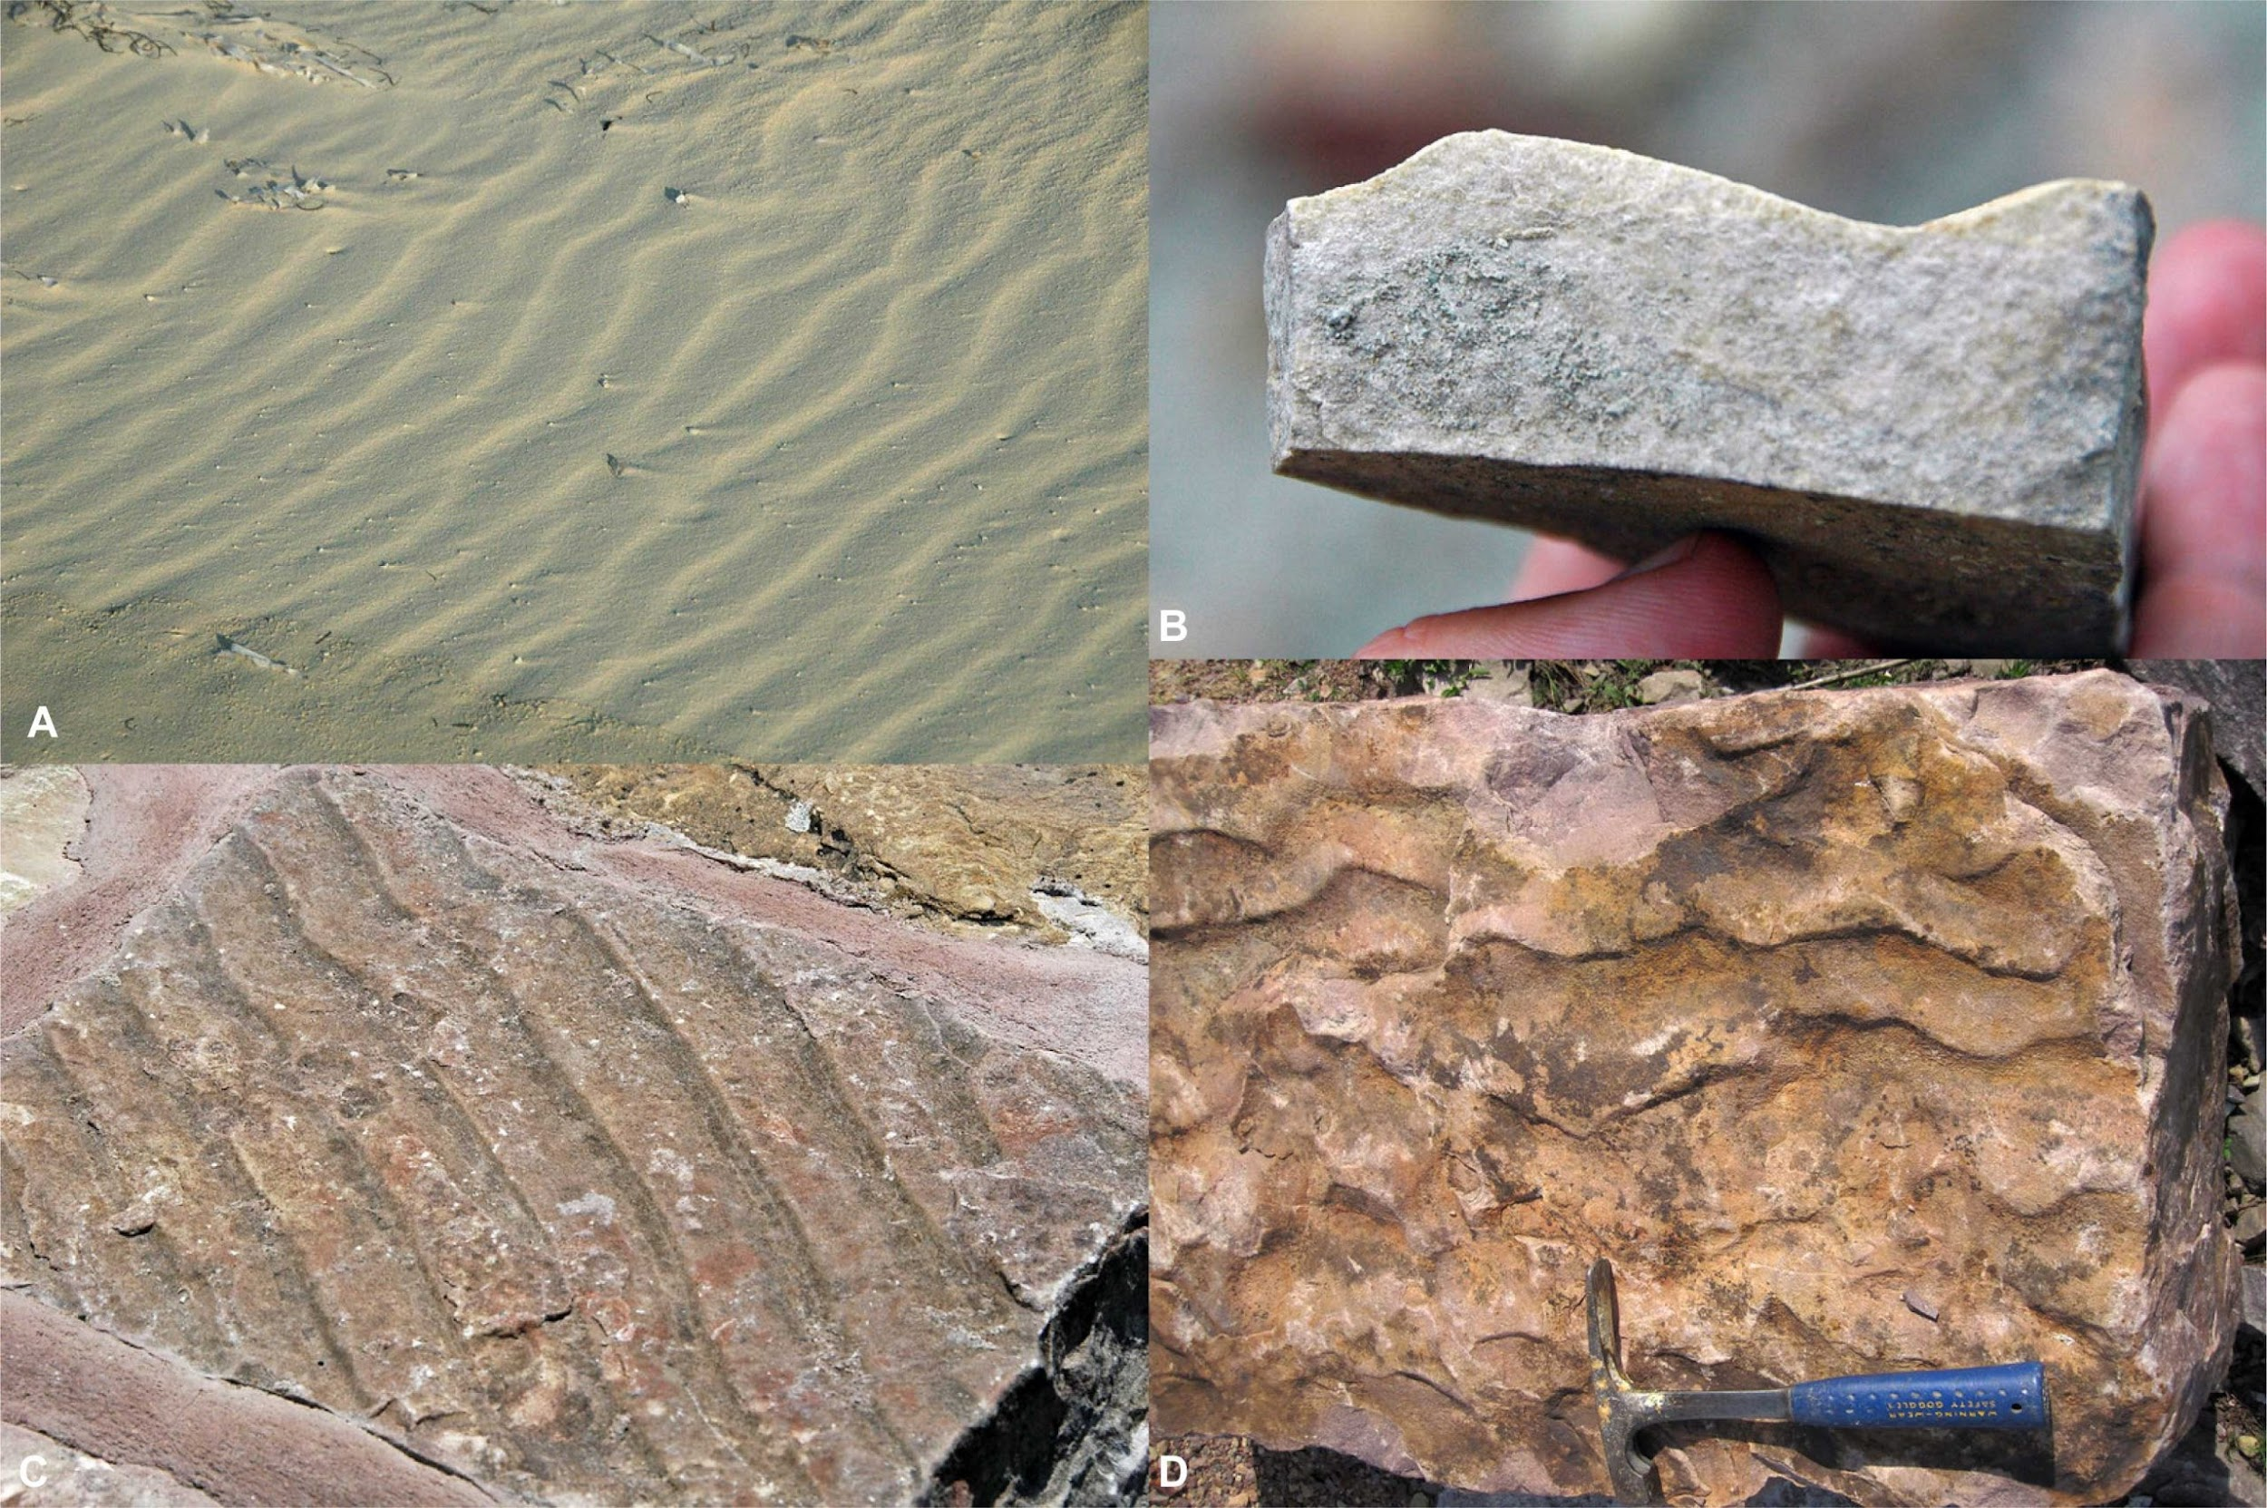
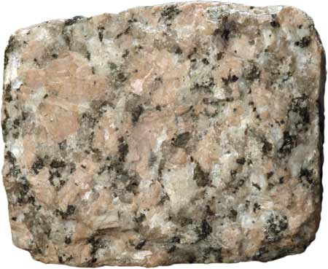
What is Geologic Time?
Each rock contains information about what the prehistoric world was like which may include:
Fossils- a record of prehistoric life
Chemical composition-what the rock is made of and how it relates to earth processes
Structures in the rock- provide clues about past earth events and environments
Uranium/Lead content- allows scientists to assign an actual age to the rock
Ripple Marks
https://www.ksfr.org/environment/2024-04-10/governors-of-nm-and-az-seek-federal-help-for-uranium-cleanup
https://rocksminerals.flexiblelearning.auckland.ac.nz/rocks/granite.html
Image credits: James St. John, CC BY.
https://en.wikipedia.org/wiki/Isotelus#/media/File:Isotelus_gigas_fossil_at_the_Smithsonian_National_Museum_of_Natural_History.jpg
Notes:
For chemical composition—the relevant idea here is that they are made up of substances that sometimes can indicate how they formed, how the environment changed them, and in some cases can be used to reconstruct specific qualities about the ancient earth, like ancient temperature, composition of the atmosphere
For structures in the rock—the ones depicted here are ripple marks, that show the way that ancient water was flowing and happened to be preserved in a rock. There are many examples of these “sedimentary structures” as they are called. Read more about them here: https://www.britannica.com/science/sedimentary-rock/Sedimentary-structures
Uranium/Lead is referring to the process of radiometric dating. For rocks, it is typically uranium/lead dating or potassium/argon dating that is used for this purpose. Students may be more familiar with the concept of carbon dating. Carbon dating is a type of radiometric dating but it can not be used to date rock layers for two reasons: one is because the half life of carbon 14 is relatively short (5730 years) so after about 60,000 years or so, the amount of carbon 14 remaining in a sample is too small to reliably date an object. Rocks are much older than that. The second reason is that carbon dating is used for objects that were once alive, since that is what incorporates carbon 14 into their structures. Ancient archeological remains (e.g., bone, wood) are typically dated this way. Uranium on the other hand has different isotopes used for dating, one has a half life of 713 million years, the other a half life of 4.5 billion years. More about radiometric dating of rocks here: https://www.nature.com/scitable/knowledge/library/dating-rocks-and-fossils-using-geologic-methods-107924044/#:~:text=To%20establish%20the%20age%20of,clocks%20to%20date%20ancient%20events.

Slide 5
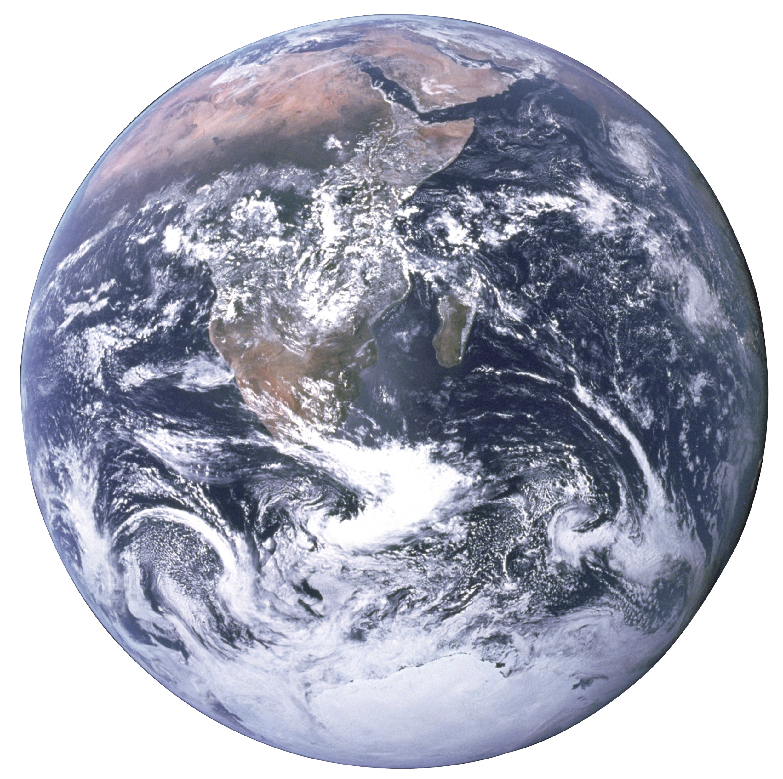
How did humans in antiquity think about the age of the Earth?
Aristotle: an ever existing earth with no first moment
Many cultures and religions placed the age of the earth in the range of of thousands, tens of thousands, or hundreds of thousands of years
Hinduism has concept of earth and universe as infinite, with death and rebirth of universe itself
Bishop Ussher (1581-1656, Church of Ireland) suggested the earth was created in 6004 B.C., using biblical chronology
Notes:
Bishop Ussher is mentioned here because his account of the age of the earth is very well known, and has had lasting effects on the way that people have interpreted the history of the Earth with respect to scripture. A modern day legacy of this is the Young Earth Creationist movement that adheres to a literal reading of scripture to assert that the earth is not billions of years old but actually thousands of years old. This assertion requires the rejection of scientific evidence about the age of the universe and the earth (among other things) and is not in alignment with Catholic teaching. Bishop Ussher belonged to the Church of Ireland, a Protestant denomination which separated from the Catholic church in 1536.

Slide 6
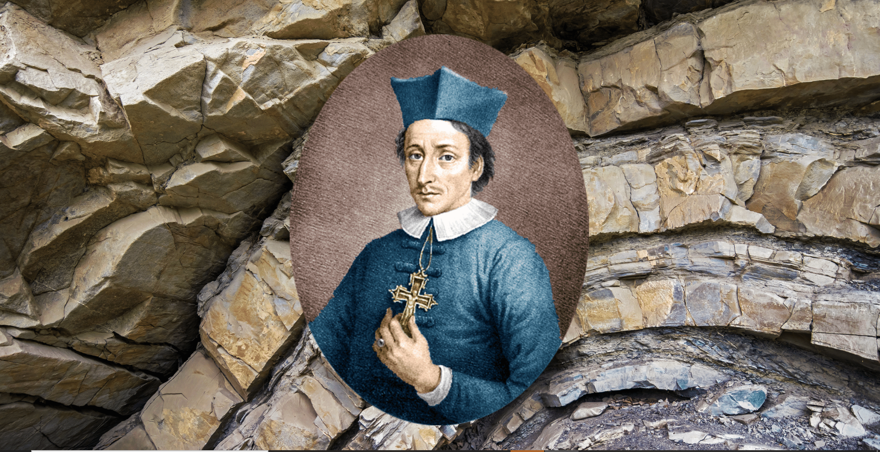
Blessed Nicholas Steno (1638-1686)
Considered the father of geology, paleontology, stratigraphy
Determined that rock layers formed in different events over long periods of time
Became a Catholic priest and eventually bishop
His work brought about scientific understanding of an ancient earth
https://ucatholic.com/blog/did-you-know-the-father-of-geology-was-a-catholic-saint/
Notes:
Nicholas Steno is an amazing figure in the history of science, and also is a great example of a prominent Catholic scientist. Highly recommend this book: The Seashell on the Mountaintop: a story of science, sainthood and the humble genius who discovered a new history of the Earth by Alan Cutler

Slide 7
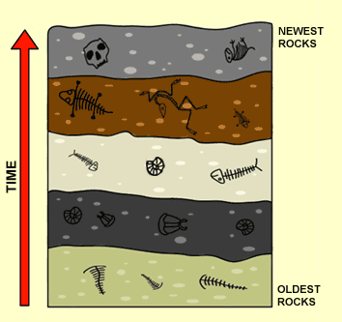
Stratigraphy: the study of rock layers and their relative ages
Involves determining whether a rock layer is older or younger than another

Slide 8
Example of Stratigraphic Concept: Law of Superposition
The oldest layers are at the bottom
and the youngest are at the top.
https://gamesmartz.com/definitions?definition=5586&law-of-superposition&s=80

Slide 9
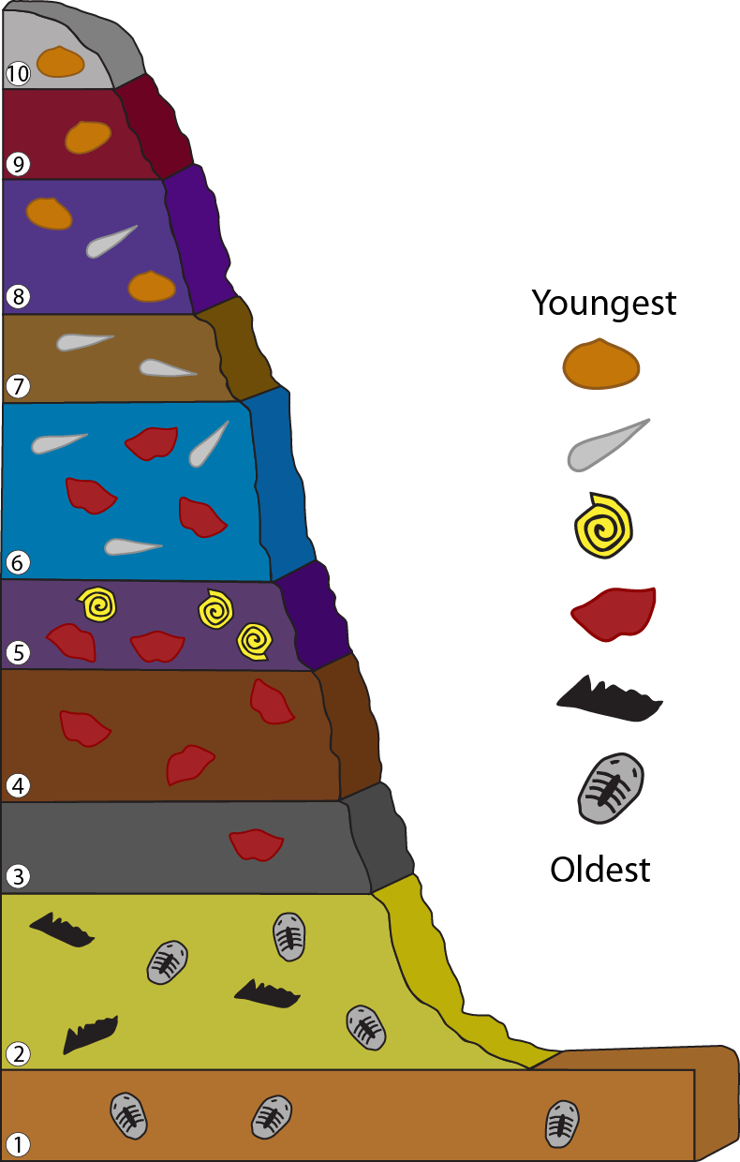
Example of Stratigraphic Concept: Law of Faunal Succession
Fossils organisms can be used to put rock layers in sequence.
Example: dinosaurs lived only during the Mesozoic Era, and so rocks bearing dinosaur fossils can be assigned to that age.
https://timescavengers.blog/introductory-material/geologic-time/principles-of-geology/
Notes:
May want to spend time explaining image on the left. That the fossils in the “key” are each only found in particular layers. For example, the oldest fossil, a trilobite is only found in layers 1 and 2. In effect, they “originated’ or appeared in the rock record in layer 1, and went extinct in layer 2. The next fossil up from that (the blobby black one) only appears in time layer 2, and so on. So each fossil can be used to determine the relative age of rock layers based on what we know about when they originate and go extinct. This is a useful principle because it can be used to correlate rocks over long distances, and sometimes across continents.
There are many other stratigraphic principles that can be explored (law of original horizontality, law of lateral continuity, law of cross cutting relationships and so on). Introductory geology or earth science texts often include this content and have interesting block diagram practice problems for students to put rock layers into a sequence according to these principles and laws.

Slide 10
The Concept of Geologic Time
18th and 19th century geologists used Steno’s methodology to order rock layers from oldest to youngest, building the first geologic time scale
These early geologists determined that the earth must be at least millions of years old
In the 20th century, the use of radiometric dating allowed scientists to assign actual ages to rock layers and events in earth history
Credit: Friedrich Haag/Wikimedia Commons, CC BY-SA 4.0
Notes:
18th and 19th century geologists of note: James Hutton, Charles Lyell, William Smith among others.
Hutton and Lyell are often associated with the principle of uniformitarianism that essentially applies present day observations of earth processes to what we see in the geologic record. This concept is often reduced to the phrase “the present is the key to the past.”
William Smith is credited with creating the first geologic map ever, which is a major accomplishment that shaped our understanding of geology from that point forward. The story of the creation of the first geologic map is detailed in the book: “The Map That Changed the World: Willaim Smith and the Birth of Modern Geology by Simon Winchester.

Slide 11
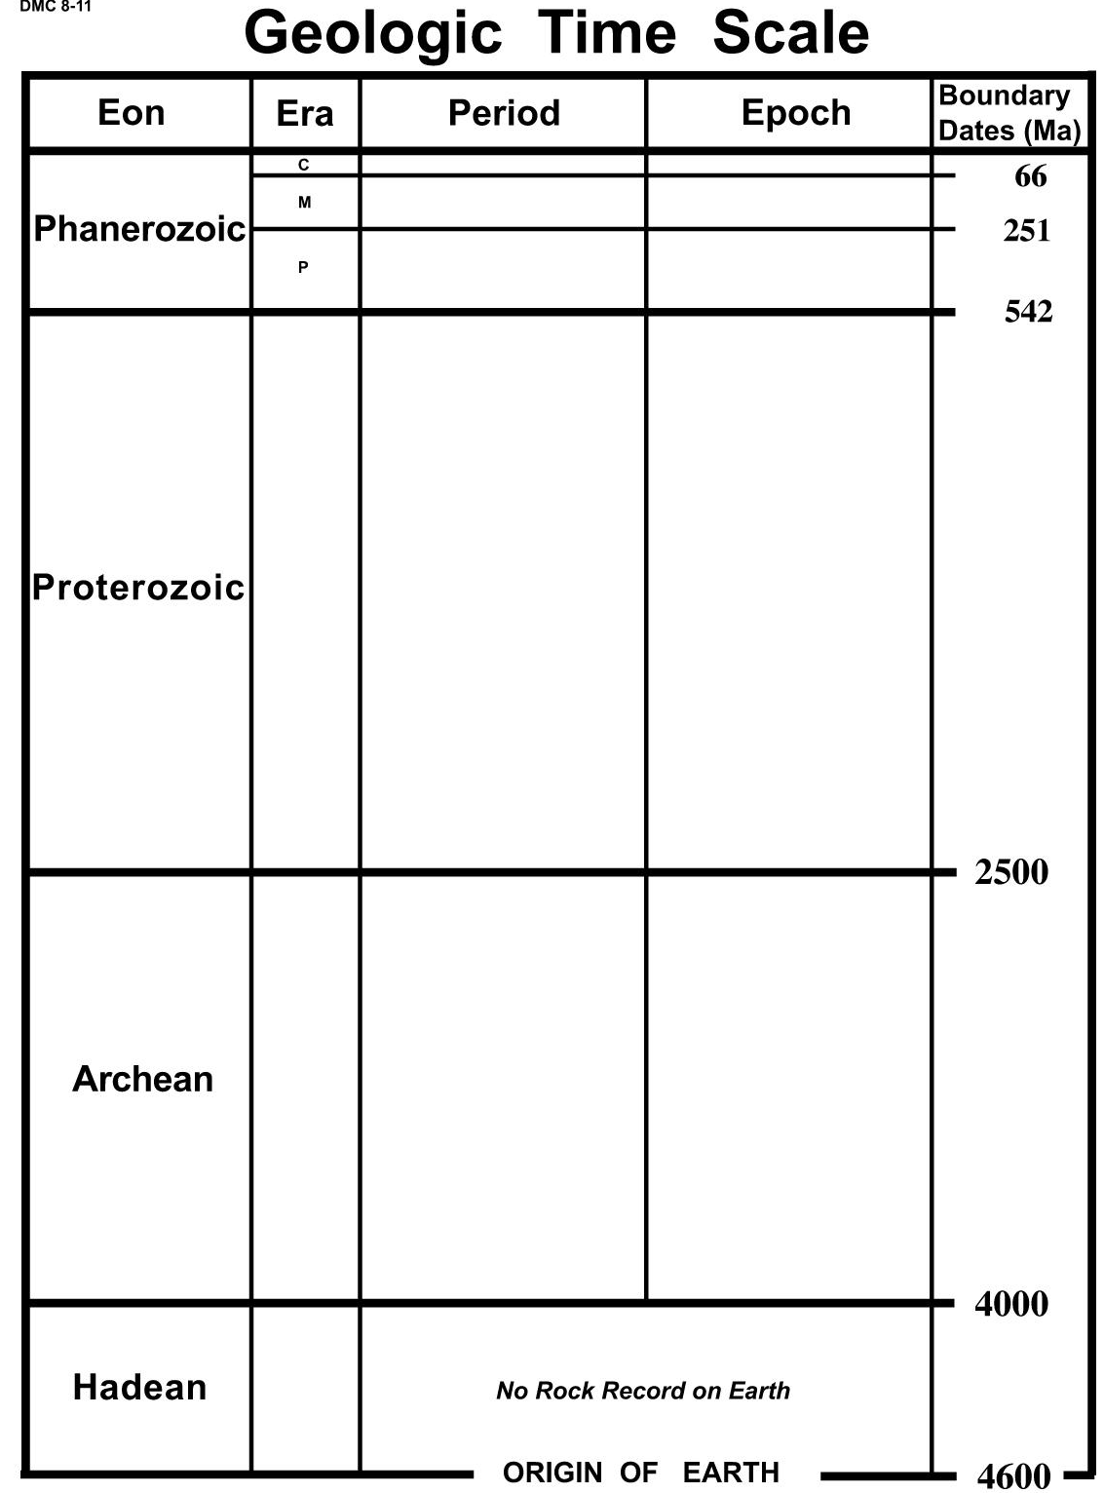
The Geologic Time Scale
Eons are the longest
lengths of geologic time.
Eras are second longest.
Eras are made of periods.
Periods are made of epochs.
The Earth is approximately 4.6 billion years old.
Geologists give names to
different spans of time of Earth’s history.
Notes:
This is a good moment to hand out the geologic time scale handout, or if the students already have it, to instruct them to get it out for reference.
The time scale on this slide is one that is drawn to scale. Most of the time you see time scales that compress the Hadean, Archaean and Proterozoic since those spans of earth history do not contain much in the way of fossils (as will be discussed on the next sequence of slides).

Slide 12
The Geologic Time Scale
The Precambrian:
Made up of the Hadean, Archaean and Proterozoic Eons.
From origin of earth to
approximately 542 million years ago.
There was not much life
during this part of the Earth’s history.

Slide 13
The Geologic Time Scale
The Phanerozoic Eon
From approximately 542 million years ago to the present day.
The Phanerozoic has
most of the fossils.
Phanerozoic means “visible life”

Slide 14
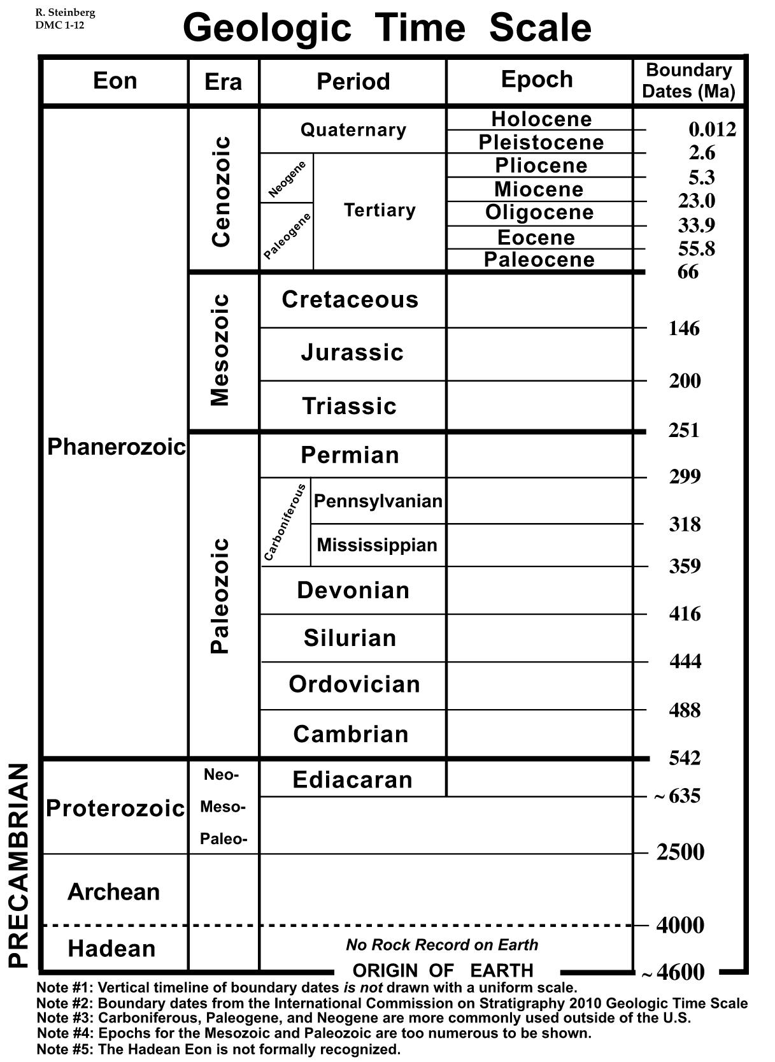
The Geologic Time Scale
The time scale on the right shows an expanded view of the Phanerozoic Eon.
Notes:
This slide will help the students understand that the other version of the time scale (with the Precambrian condensed) is showing the Phanerozoic in much more detail. This is the more familiar depiction of the time scale that concentrates much more on the Phanerozoic, since these times periods/eras are defined by changes that can be seen by examining the fossil record.

Slide 15
The Geologic Time Scale
The Paleozoic Era
The time of “early life”
542-251 million years ago
This was BEFORE the dinosaurs.
Notes:
Some additional context if desired:
The fossils in Paleozoic include lots of sea creatures, but also some of the first amphibians and reptiles (but not dinosaurs yet) and the first forests. This era includes the transition of life from the oceans to the land. There were three mass extinctions that happened during this era: The late Ordovician, the late Devonian and the end Permian.
Much more to say, of course. Could expand discussions about all of these time periods, if desired. A great reference for this: https://ucmp.berkeley.edu/help/timeform.php

Slide 16
The Geologic Time Scale
The Mesozoic Era
“The Time of Dinosaurs”
251-66 million years ago
Notes:
Additional context:
Two mass extinctions during the Mesozoic—the end Triassic and the end Cretaceous.
Major developments—dinosaurs AND mammals in the Triassic (though mammals did not become dominant until after the non-avian Dinosaurs went extinct at the end of the Cretaceous.
First birds—in the Jurassic (evolved from Dinosaurs, so technically birds are “avian dinosaurs” and the dinosaur clade is not entirely extinct because we still have birds. So…paleontologists refer to the extinct dinosaurs as the “non-avian dinosaurs” and birds as “avian dinosaurs.” Archaeopteryx is a famous fossil that embodies the evolutionary transition from non-avian to avian dinosaurs.
Another development in the Mesozoic—the first flowers, which had a big impact of the co-evolution of insects and plants from that point forward.

Slide 17
The Geologic Time Scale
The Cenozoic Era
Era of “Recent Life”
After the non-avian dinosaurs went extinct.
The “Time of Mammals”
66 million years ago to present
Notes:
The Cenozoic includes the time period that we are in today (the Holocene).
Often considered the “time of mammals” although mammals have actually been on the earth since the Triassic. They just became dominant once the non-avian dinosaurs went extinct at the end of the Cretaceous because of the asteroid impact.
Note that the time period boundaries on the time scale are very finely divided—this version of the time scale is not to scale at all, the Cenozoic is a very short time period respectively speaking. For example, the Cenozoic is just 66 million years long. In comparison, the Cretaceous on its own is 80 million years long, so longer than the entire Cenozoic.

Slide 18
Question to ponder:
What do you think causes a scientist to place a boundary in a particular place on the time scale?
In other words: why do you think scientists decided to start and end the various Eons, Eras, Periods, and Epochs at the boundary dates listed on the right side of the time scale?
Notes:
These questions are included in the guided notes worksheet for the students. They could fill in those prompts during the presentation, or maybe by discussing in pairs, or could be completed as homework later if class time is an issue.
Answer to these prompts is explored on the next slide, also detailed on instructor version of the guided notes.

Slide 19
So how did scientists determine when intervals of geologic time begin and end?
Recognizing major changes to rock layers around the world
Major changes to the environments of rocks (e.g., rocks that formed under water overlain by rocks that formed on land because of global sea level fall)
A chemical change in the rocks (e.g., rocks suddenly contain more carbon)
A change to the fossils (e.g., a mass extinction event)
The boundaries between Eons, Eras, Periods and Epochs are largely defined by events and changes in Earth history.
The rocks themselves reveal that history in their chemistry, stratigraphy and fossils.
Radiometric Dating allowed scientists to assign actual ages to these rocks.
Notes:
This is the answer to the “questions to ponder”
Connects back to the ideas of stratigraphy developed by Bl. Nicholas Steno. This is the “data” of geology. Fossils, chemistry, qualities of rocks, radiometric dating---which connects back to the 4th slide of this presentation.

Slide 20
The Earth is really, really, really old
~4.6 billion years old
If you tried to count to 4.6 billion, counting once per second, 24 hours a day without ever taking a break, it would take 147 years to count to 4.6 billion.
https://www.surfnetkids.com/resources/geologic-time-scale/
Notes:
This brings the lecture out to the big picture—the full age of the earth. This is what the exercise on Day 2 will explore, when the students will actually make a scale model of Earth history. This exercise always results in an “AHA” moment where students can get a better sense of the true age of the earth with respect to when human beings show up (which is just ~300,000 years ago)

Slide 21
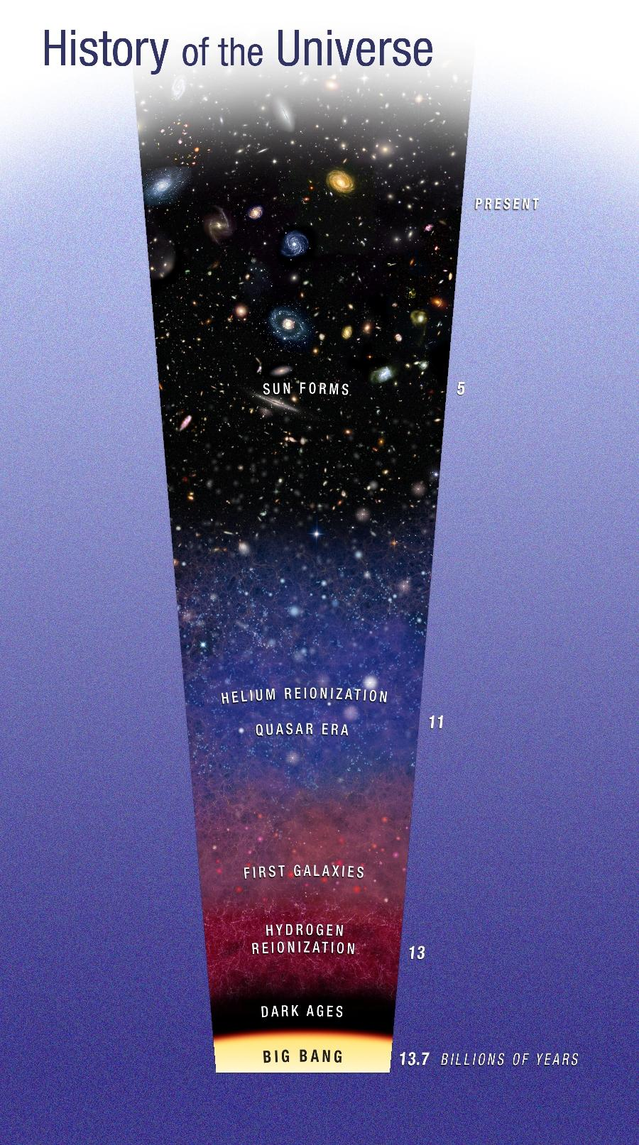
The Universe is even older.
~13.7 billion years
Predates the earth by ~9 billion years
We need an old universe (with stars being born and dying) to create the heavier elements that form our Earth and even our bodies!
https://stardate.org/print/15304
Notes:
In terms of the concept of time, it’s useful to recognize that the earth is just one portion of how we scientifically understand time, with the Big Bang as the scientific staring point.
Factoid: the scientist who proposed the concept of the Big Bang was a Catholic priest by the name of Georges Lemaître. Another great example of a Catholic scientist. More about him here: https://www.britannica.com/biography/Georges-Lemaitre
The death of stars is what creates heavier elements—through nuclear fusion, and when they experience supernovae, those elements are dispersed through the universe, and eventually coalesce into new stars and planets. These are the ingredients that make our bodies, and so we are indeed “stardust” in this sense. We need an old universe in order to exist.

Slide 22
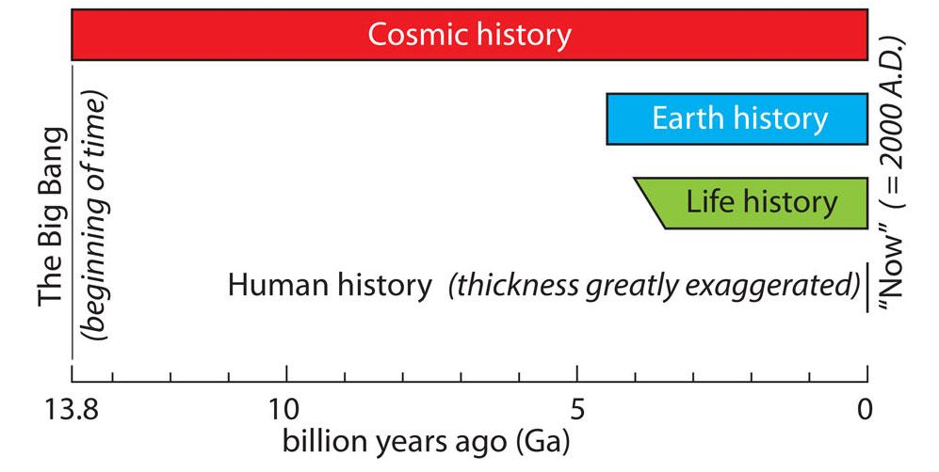
When and how do humans fit into all of this?
https://ucmp.berkeley.edu/2019/09/chronozoom-time-atlas-of-earth-big-history/
Notes:
This image puts four things into perspective 1) the age of the universe “cosmic history” 2) the age of the earth “earth history” 3) life history (when we think life first took hold on the earth). Note that the starting time is a slanted line on this image, which indicates that we’re not quite sure when this actually happened. Some evidence suggests as early as 4 billion years ago. We have definitive fossils (known as stromatolites) from 3.5 billion years ago. And 4) Human History, depicted here as a short line, which is actually thicker than it should be if the scale was accurate.

Slide 23
Summary
The geologic time scale organizes and depicts the events of Earth history
Rocks provide the evidence for the history of our planet
In the 17th century, Blessed Nicholas Steno founded the science of Stratigraphy that uncovered this geologic history
The scientists of the 20th century crafted the modern geologic time scale and assigned dates to geological eons, eras, periods, epochs
The geologic time scale is divided up into times defined by events that happened in Earth’s history
Origin of Earth
Today
This file is licensed under the Creative Commons Attribution-Share Alike 4.0 International license.

